Slide 1


Slide 2
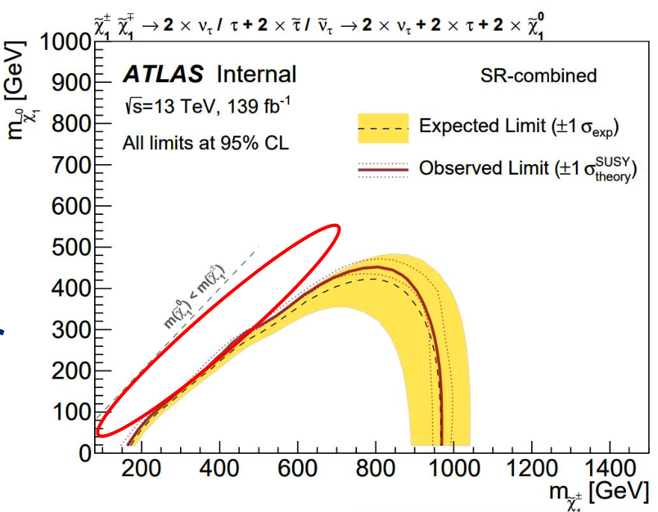
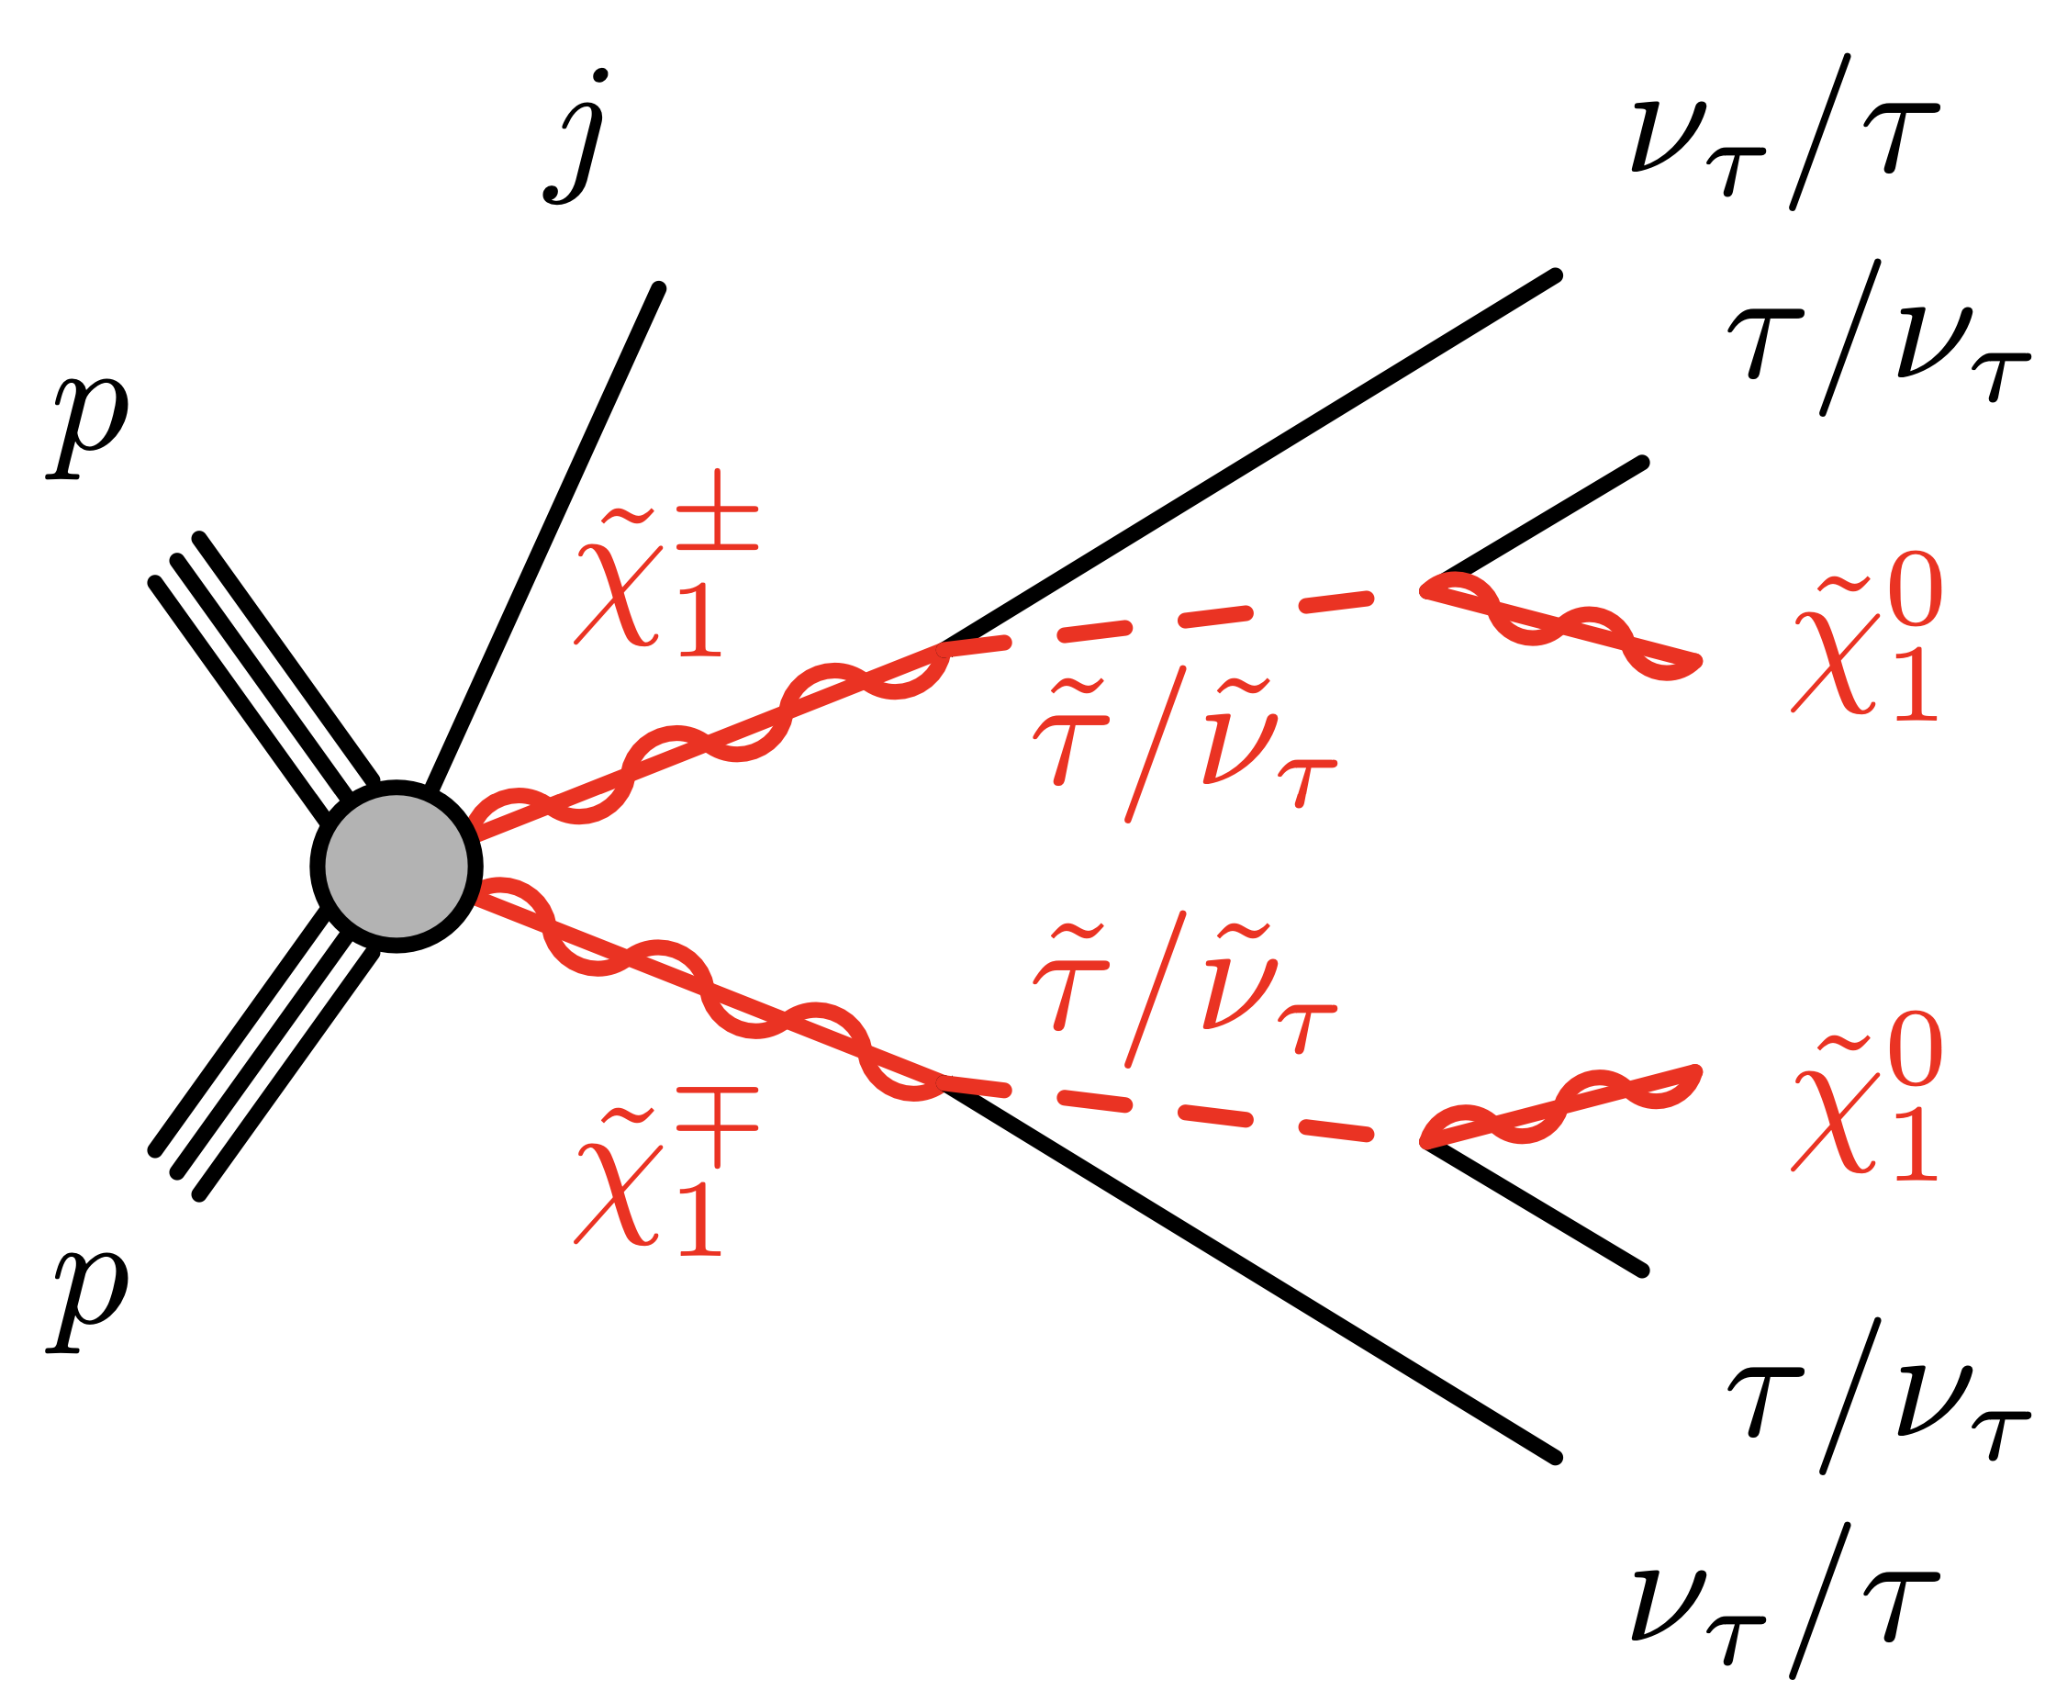
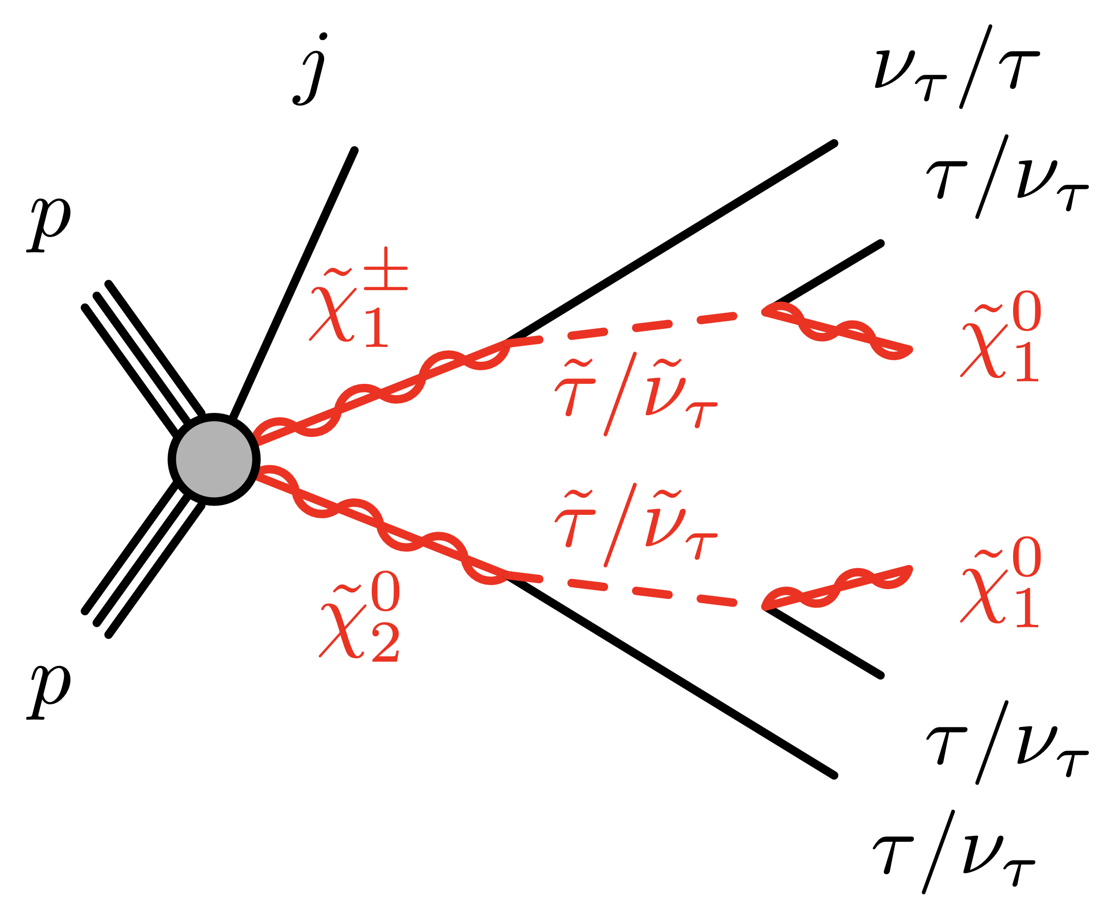
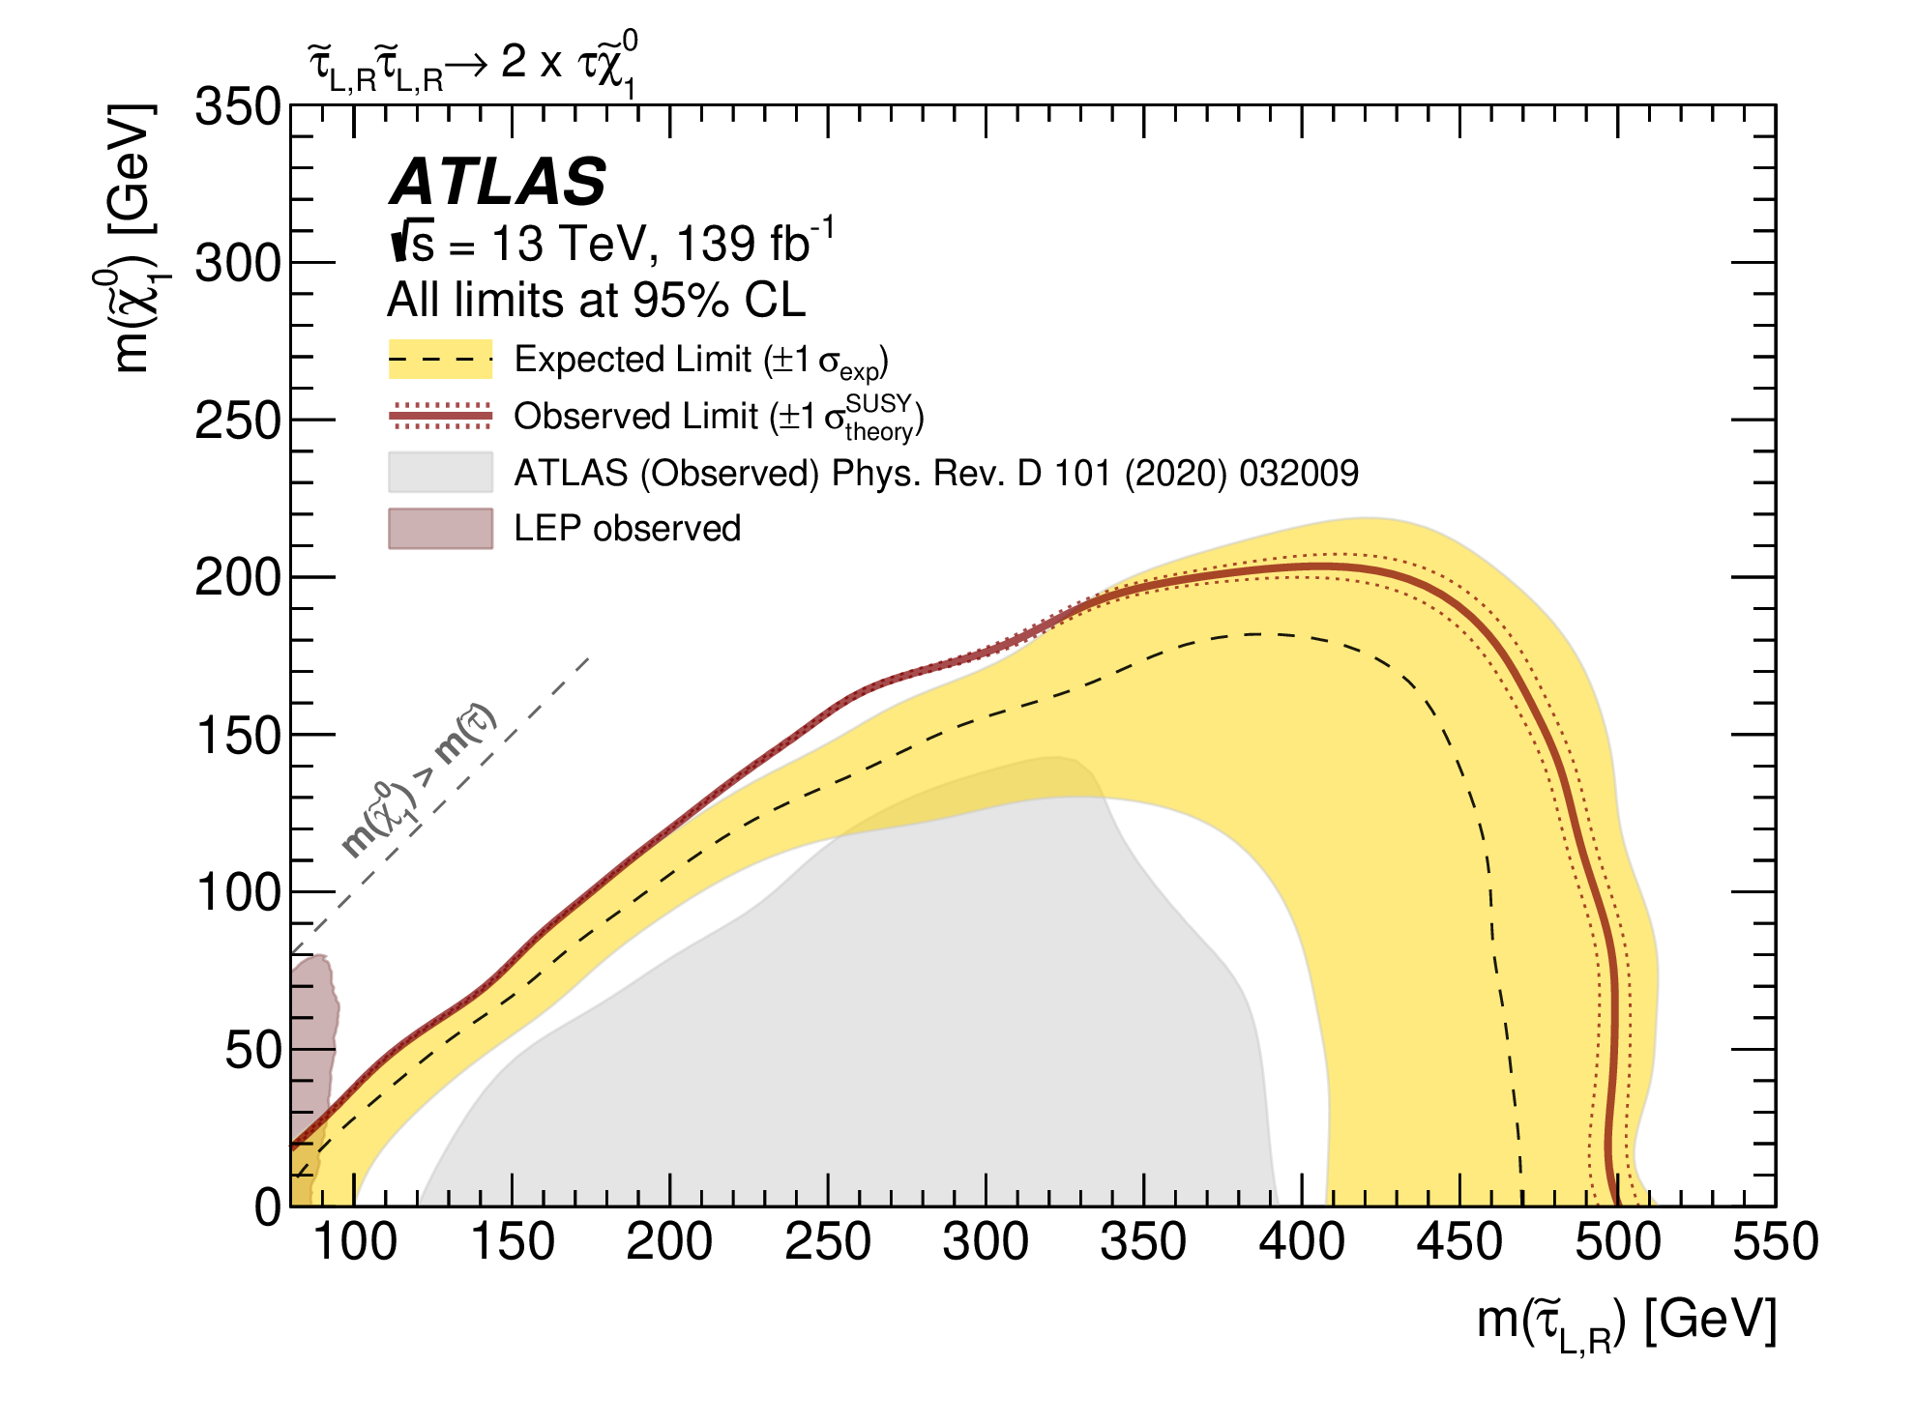
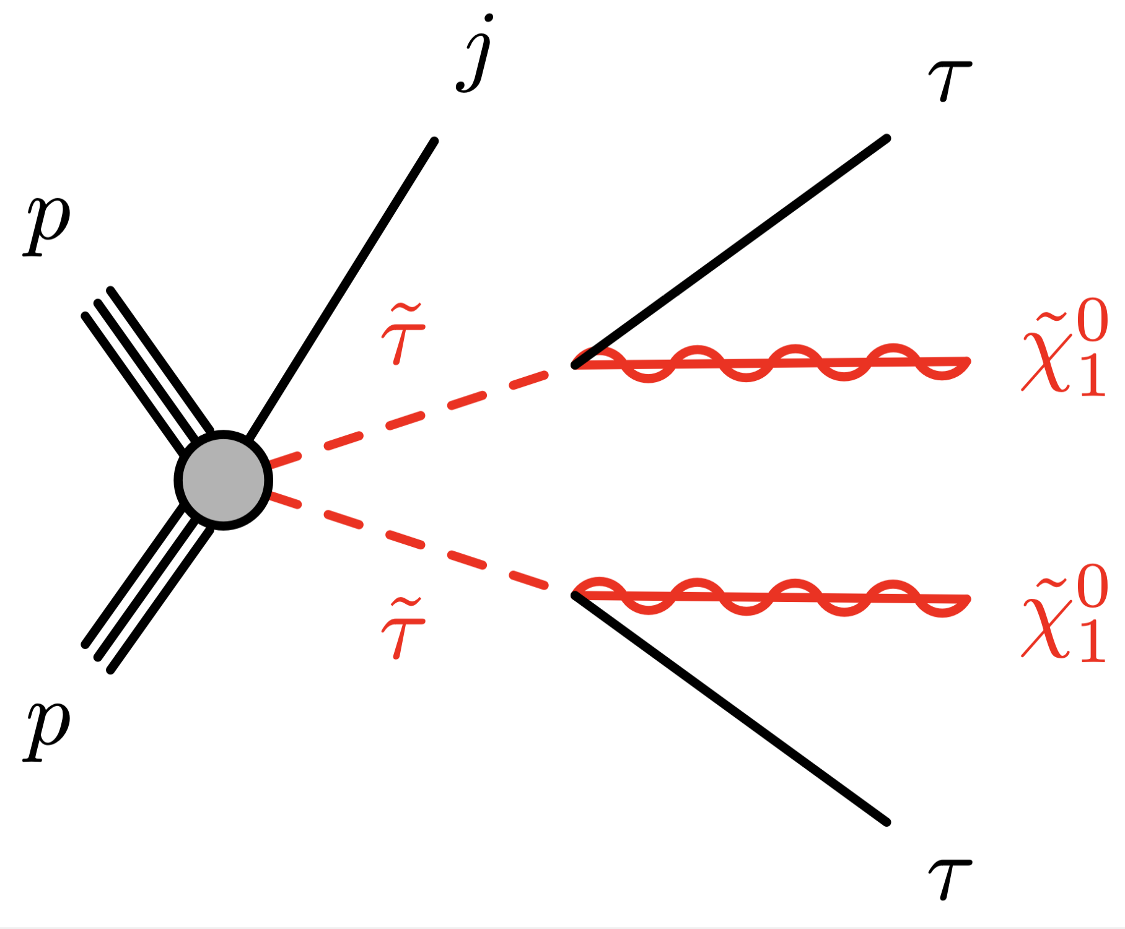
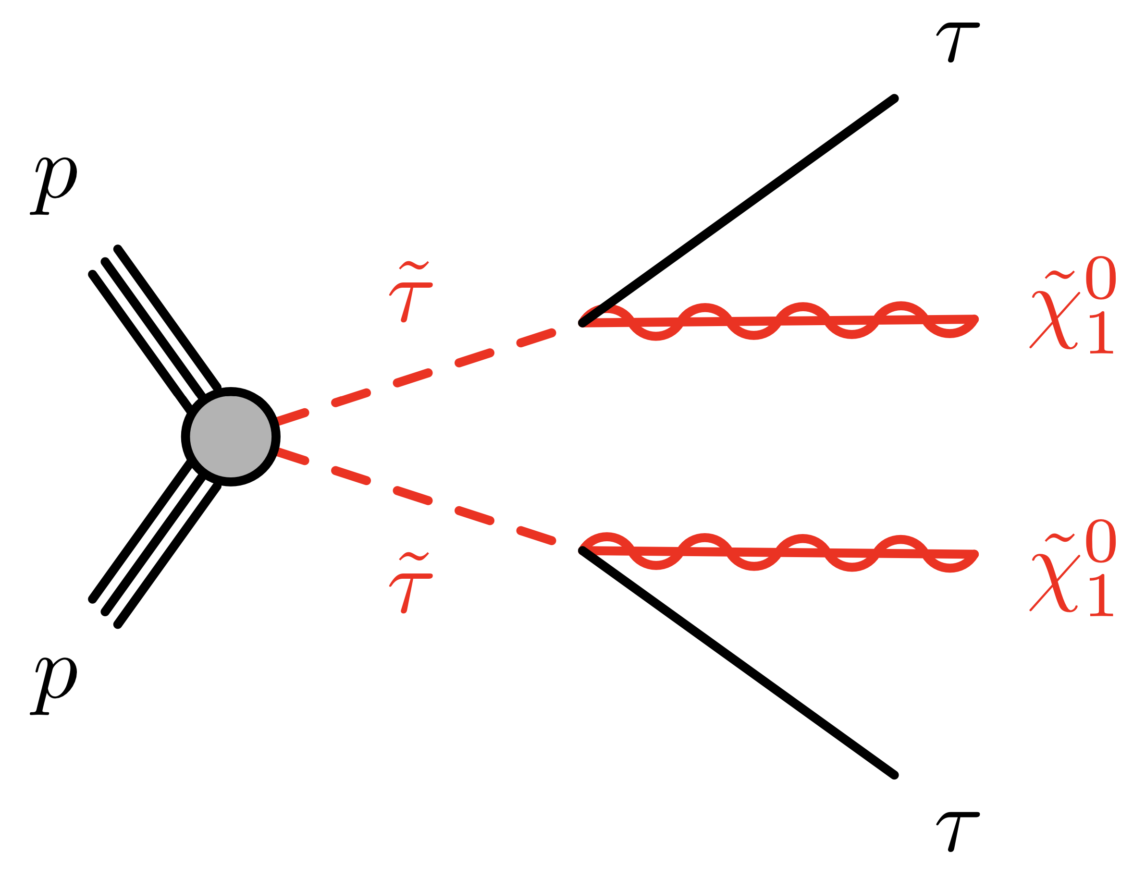
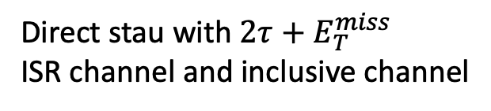
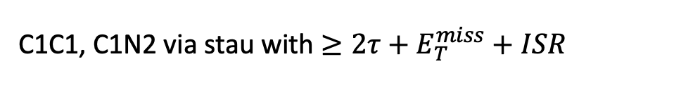
Target Signal
C1C1, C1N2 via stau with $≥2τ+E_{T}^{miss}+ISR$
Direct stau with $2τ+E_{T}^{miss}$ ISR channel and inclusive channel
1 or 2 jets, leading jet at least 50 GeV
0,1,2, jet
Previous paper: JHEP 05 (2024) 150
Motivation: an explanation for observed excess in the Muon g-2 experiment and the measurement of dark matter relic density ISR can boost the SUSY system and improve the sensitivity in compressed region
Glance Analysis entry: ANA-HMBS-2024-07
Internal Note: ANA-HMBS-2024-07-INT1

Slide 3
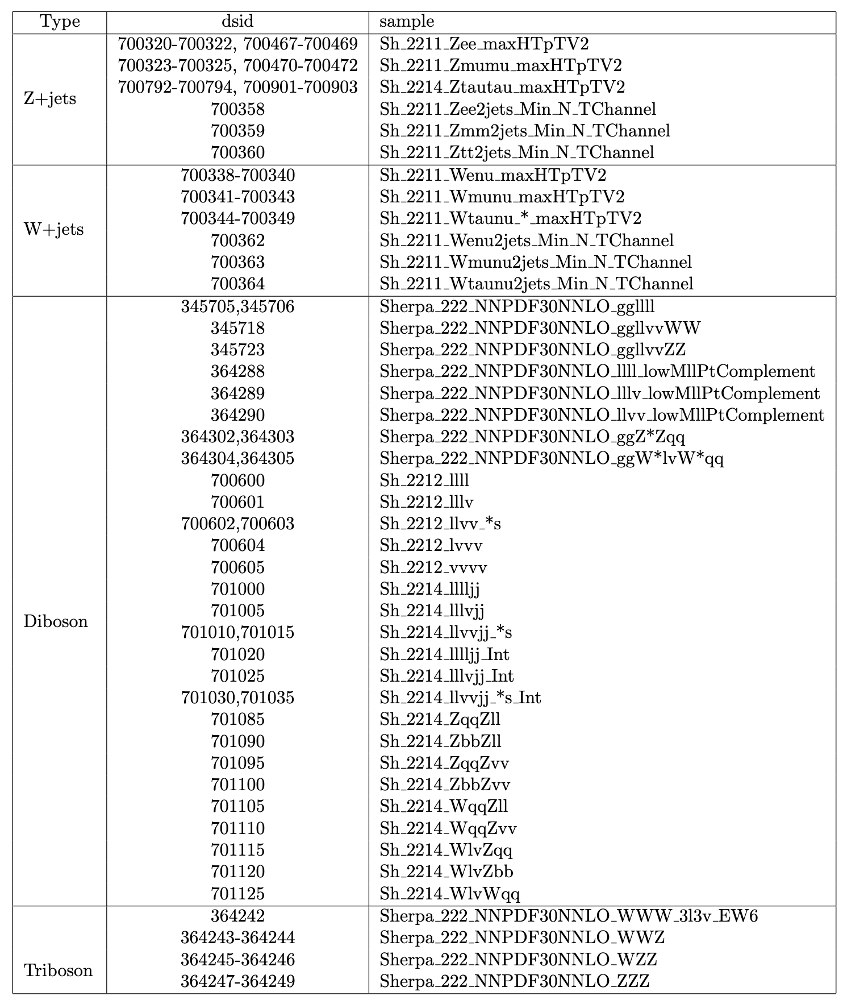
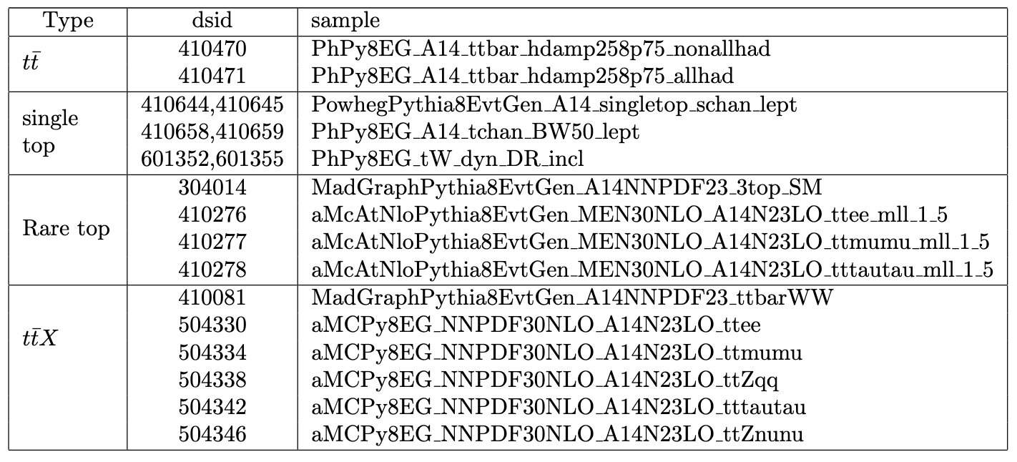
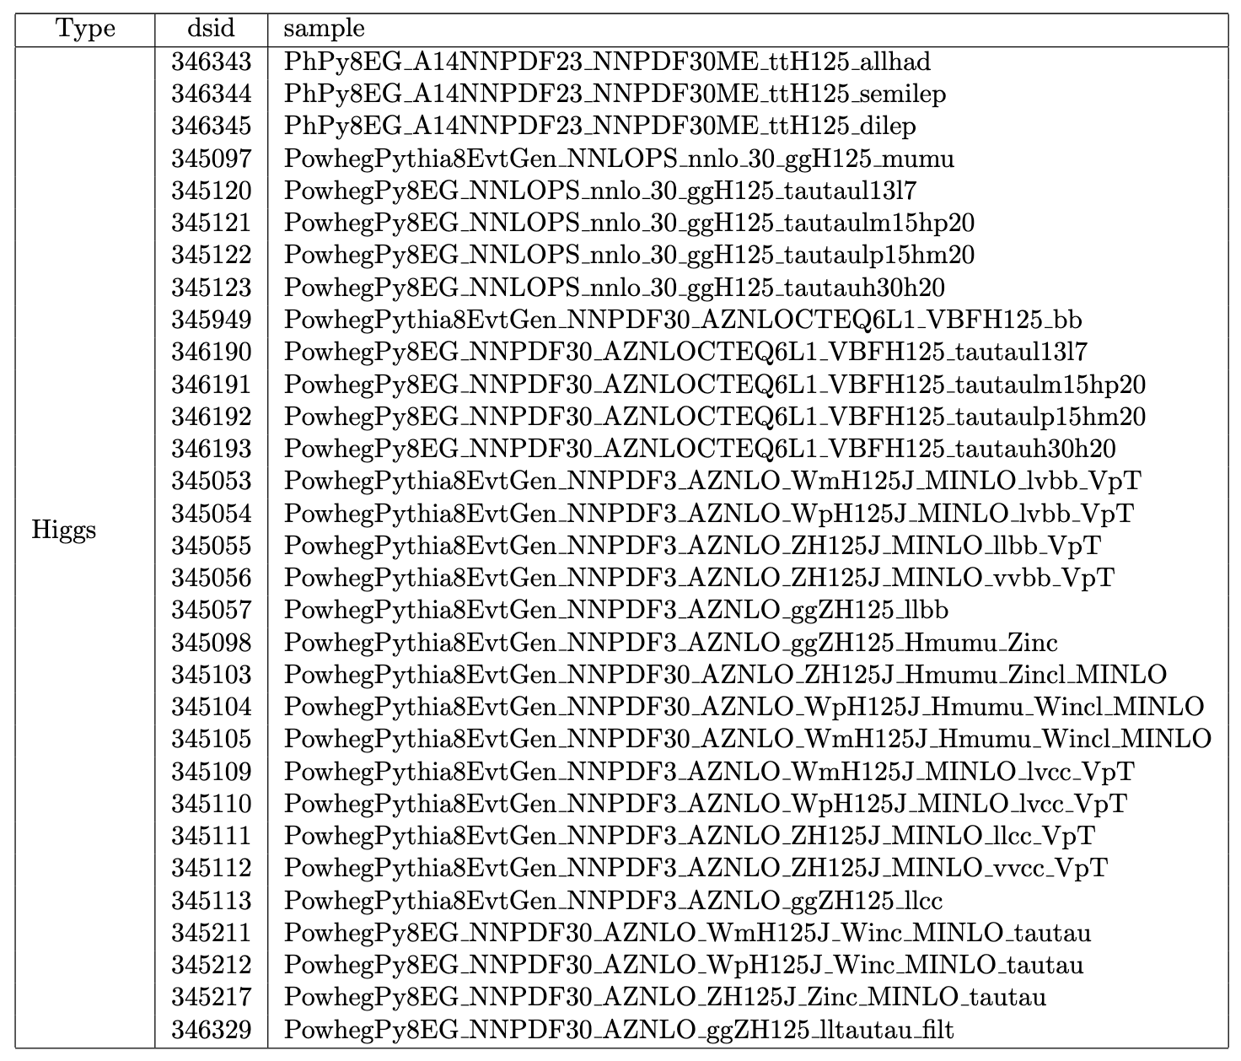
Ntuple setup
MelAnalysis framework
Dataset: full run2 + partial run3
DAOD PHYS
ptag: signal p6244, bkg p6490/p6491, data p6479/p6269
background list: mc20, mc23;

Slide 4
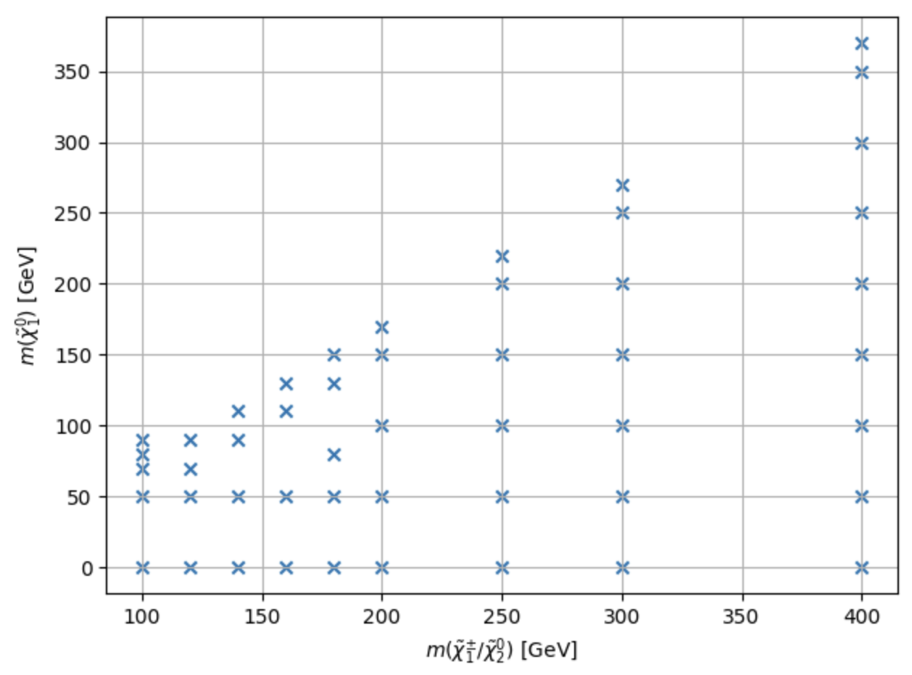
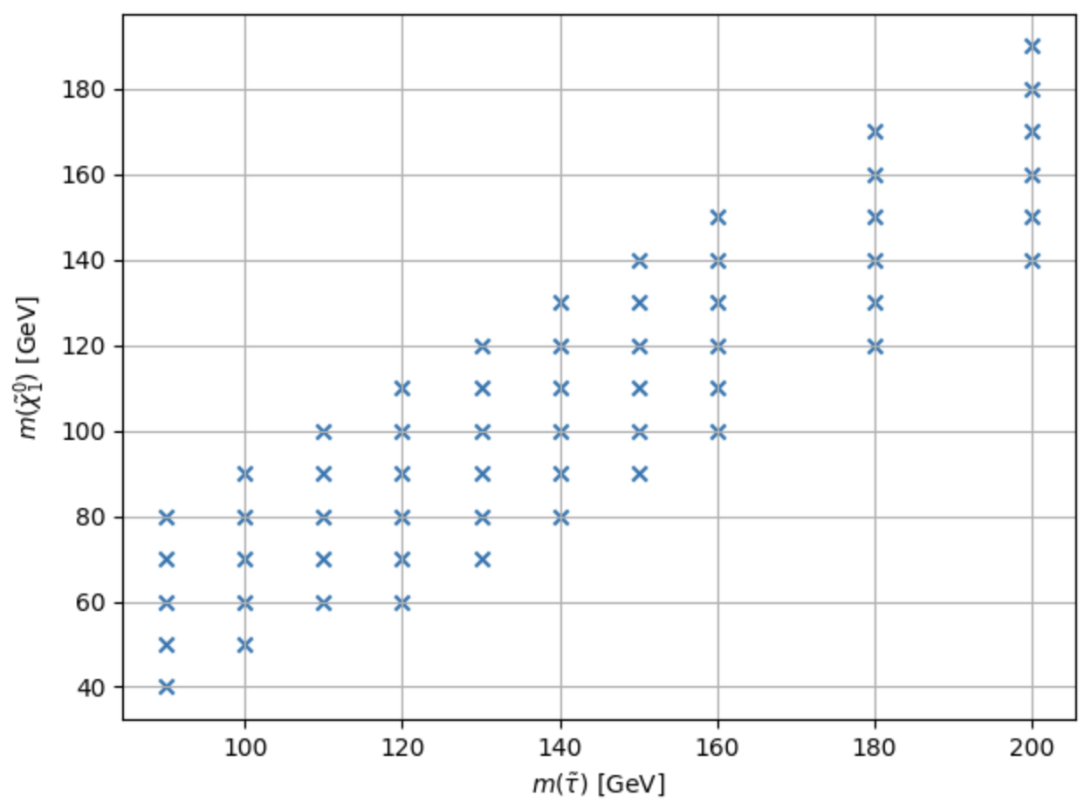
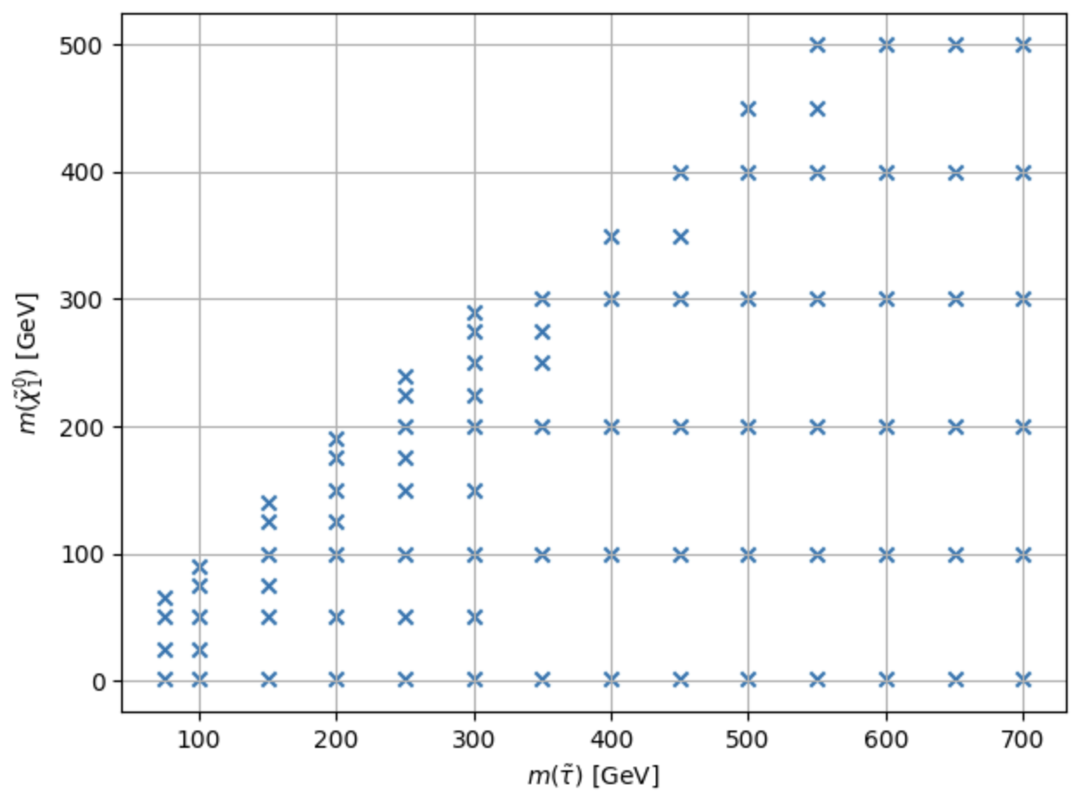
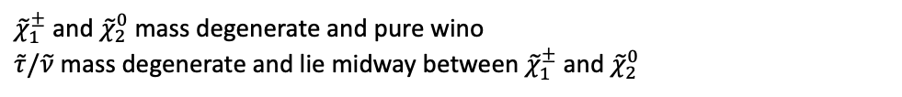
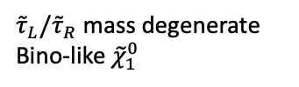
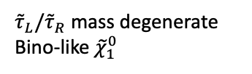
Signal samples
${\tilde{τ}}_{L}/{\tilde{τ}}_{R}$ mass degenerate
Bino-like ${\tilde{χ}}_{1}^{0}$
${\tilde{χ}}_{1}^{±}$ and ${\tilde{χ}}_{2}^{0}$ mass degenerate and pure wino
$\tilde{τ}/\tilde{ν}$ mass degenerate and lie midway between ${\tilde{χ}}_{1}^{±}$ and ${\tilde{χ}}_{2}^{0}$
${\tilde{τ}}_{L}/{\tilde{τ}}_{R}$ mass degenerate
Bino-like ${\tilde{χ}}_{1}^{0}$
leading jet > 50
pt lepton 20GeV
(100,70)
(150,100)
(100,70)
(100,50)
Notes:
Mark with ref point

Slide 5
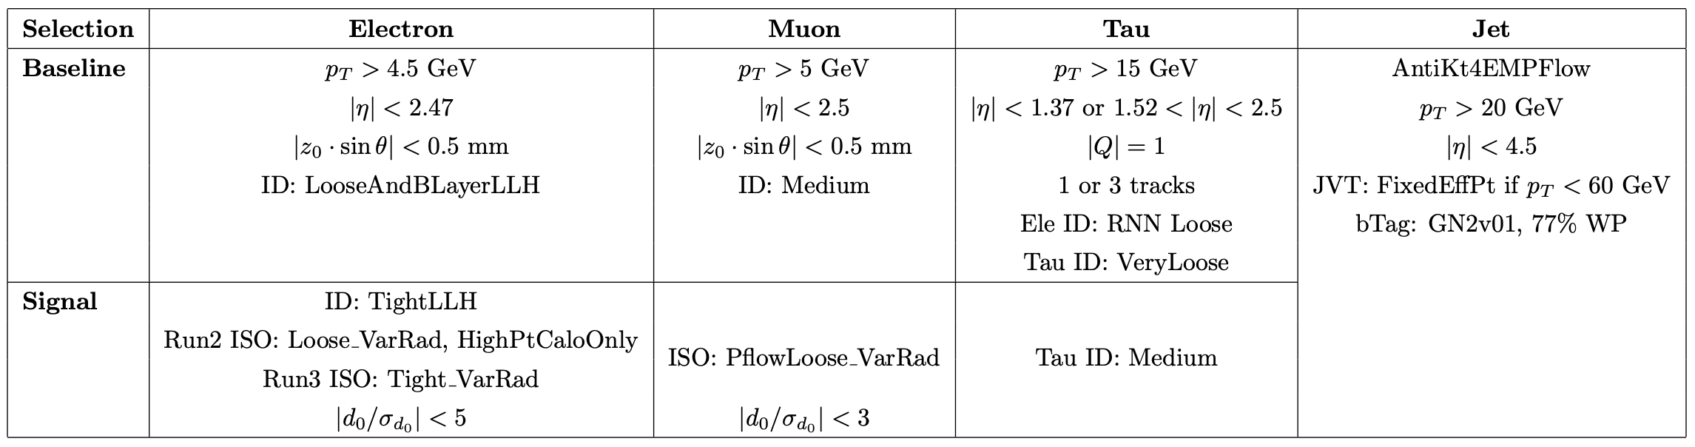
Object Definition
Full ST config: Run2, Run3
Follow the CP recommendation

Slide 6
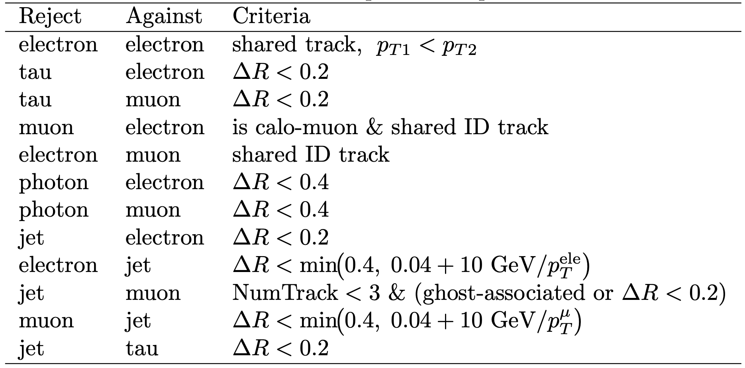
Overlap Removal
ST default overlap removal
Do Tau OLR

Slide 7
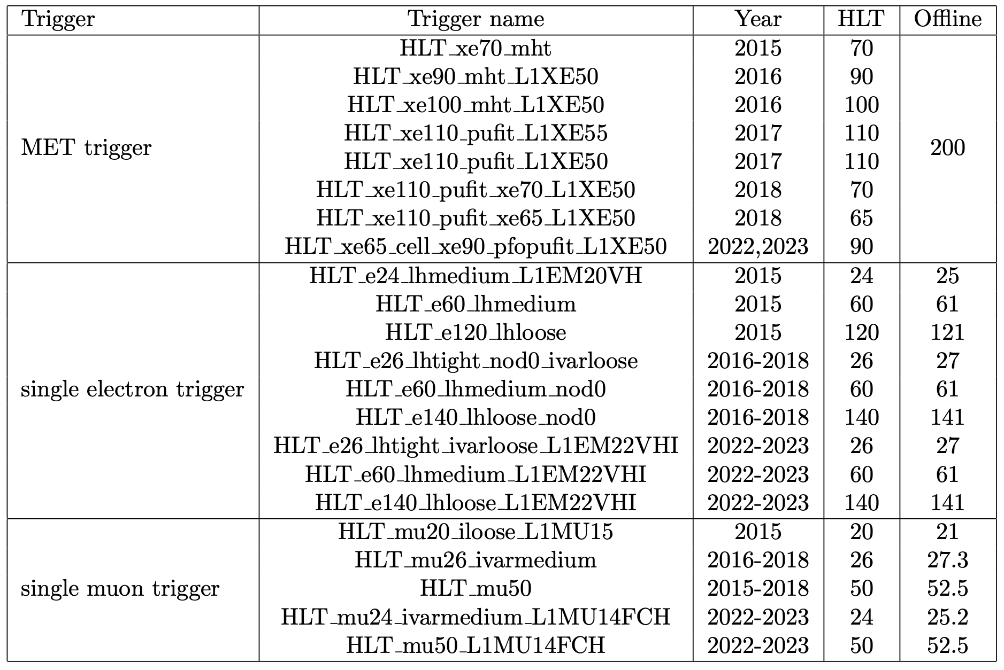
Trigger Strategy
Stau:
MET trigger for MET >= 200,
Single lepton trigger for MET <= 200
C1C1/C1N2: MET trigger

Slide 8
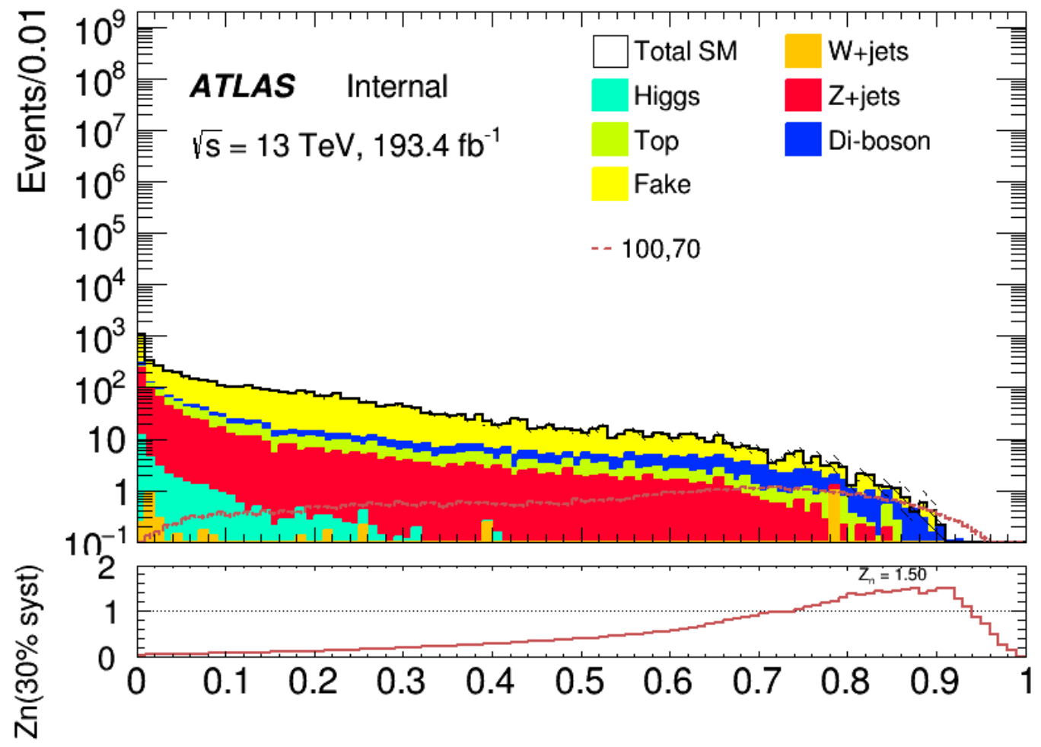
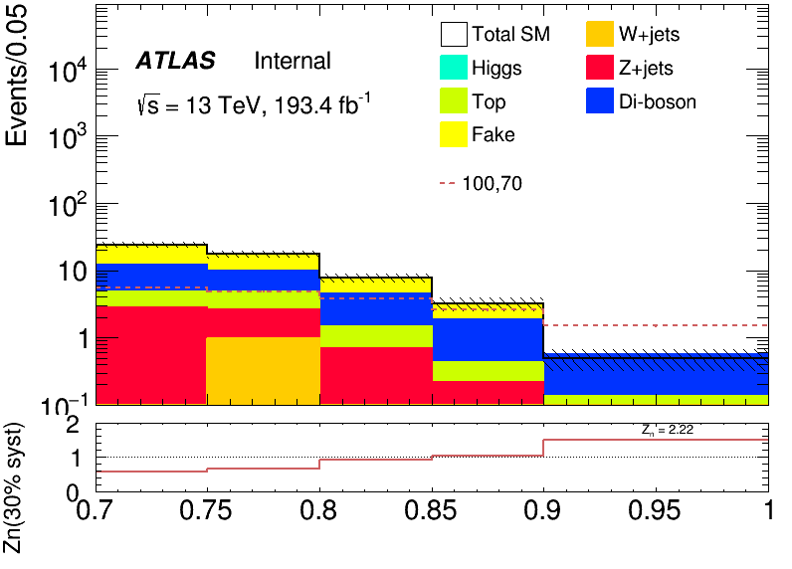
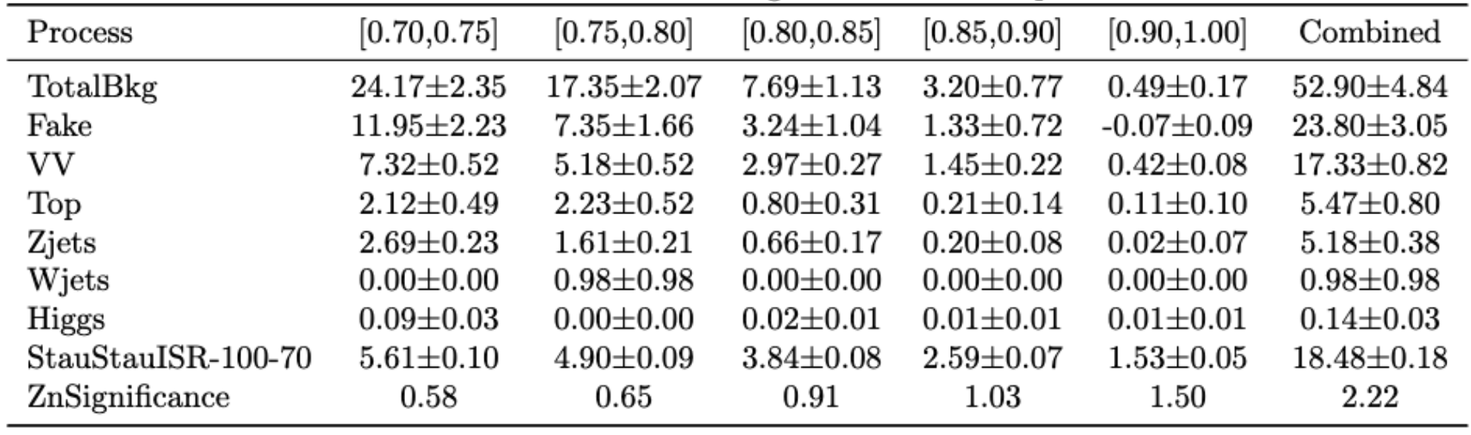
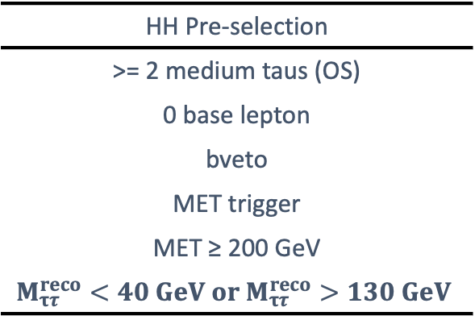
Direct Stau ISR signal region definition(HH)
Preselection
Data/MC include in Backup at Preselection level
Combined Zn 2.22
HH Pre-selection
>= 2 medium taus (OS)
0 base lepton
bveto
MET trigger
MET ≥ 200 GeV
$$M_{ττ}^{reco}<40 GeV or M_{ττ}^{reco}>130 GeV$$
Fake tau: W+jets, Top(Fake factor method)
SR selection using neural network score
ML detail include in Backup
Background composition
Real tau: scaled with CRs, validate with VRs
SR
Pre-selection
DNN score > 0.7
Dominant

Slide 9
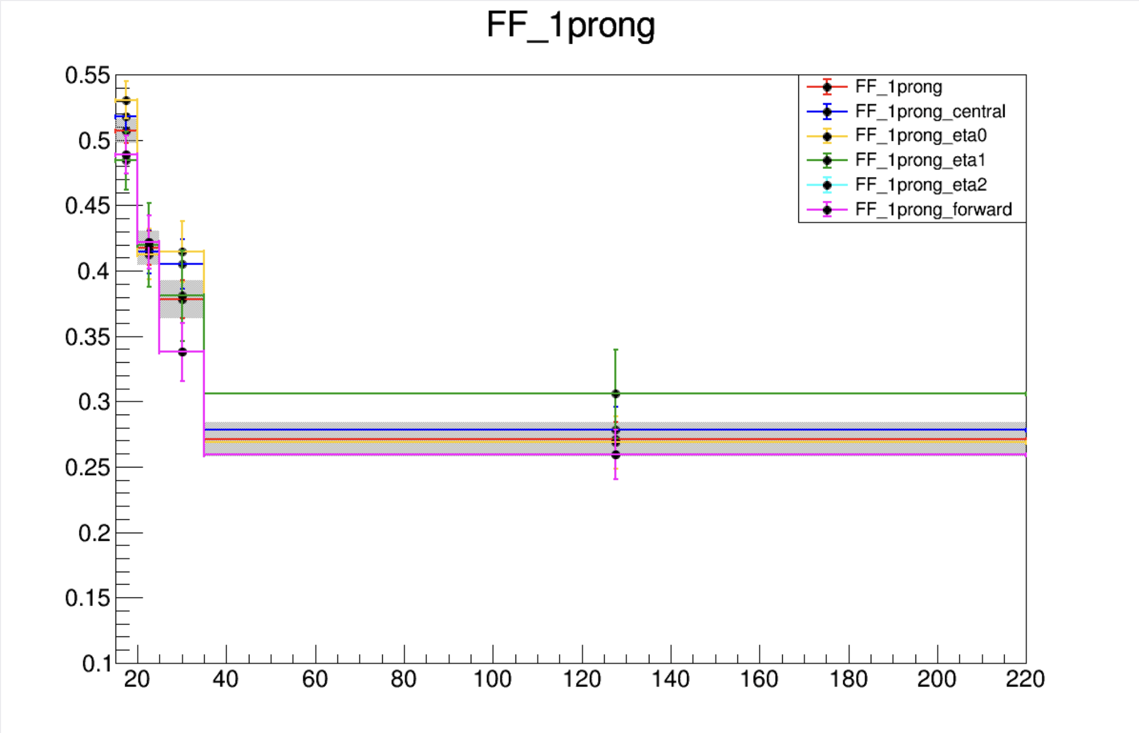
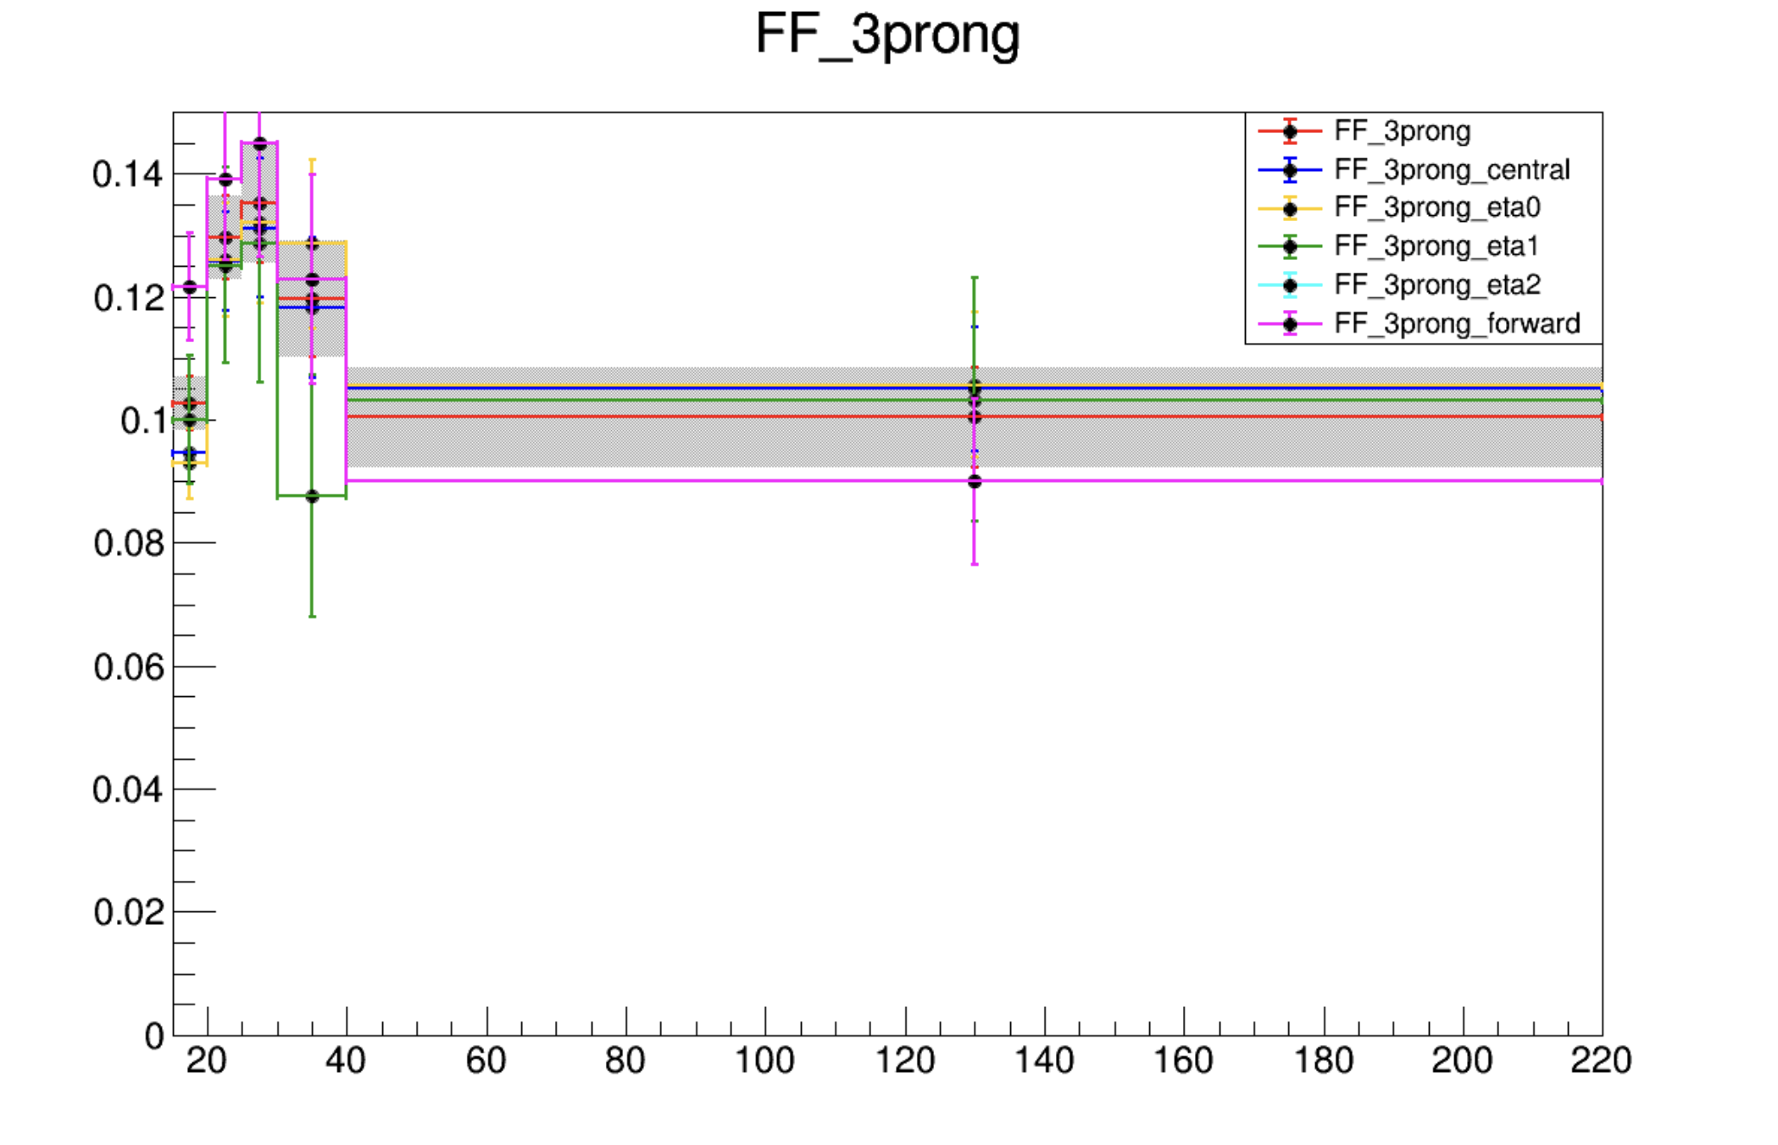
Direct Stau ISR fake estimation
CRs (fake factor computation)
METtrig
MET>=200
bveto
1 signal lepton
SS (orthogonal with ISR SR)
ID: >= 1 medium tau
antiID: >= 1 VeryLoose tau, 0 medium tau
SRs
preselection
2ID: >= 2 medium tau
1ID1antiID: >= 2 VeryLoose tau , 1 medium tau
2antiID: >= 2 VeryLoose tau , 0 medium tau
FF determination
Data
FF application
Data
CR
Pass ID
SR
Pass ID
SR
but
1 tau Fail ID
CR
Fail ID
SR
but
2 tau Fail ID
Binned in prongness, tau eta, tau pT
Eta bins
2 bins: central [0,1.37], forward [1.52,2.5]
3 bins: eta0,1,2 for [0,1), [1, 1.37], [1.52,2.5]
Auto binning:
> 10% of events in nominator and denominator
Add bins to bin i until it is not consistent anymore with bin i - 1
Relative stat uncertainty on ratio smaller than 50%
>10% events in nominator and denominator

Slide 10
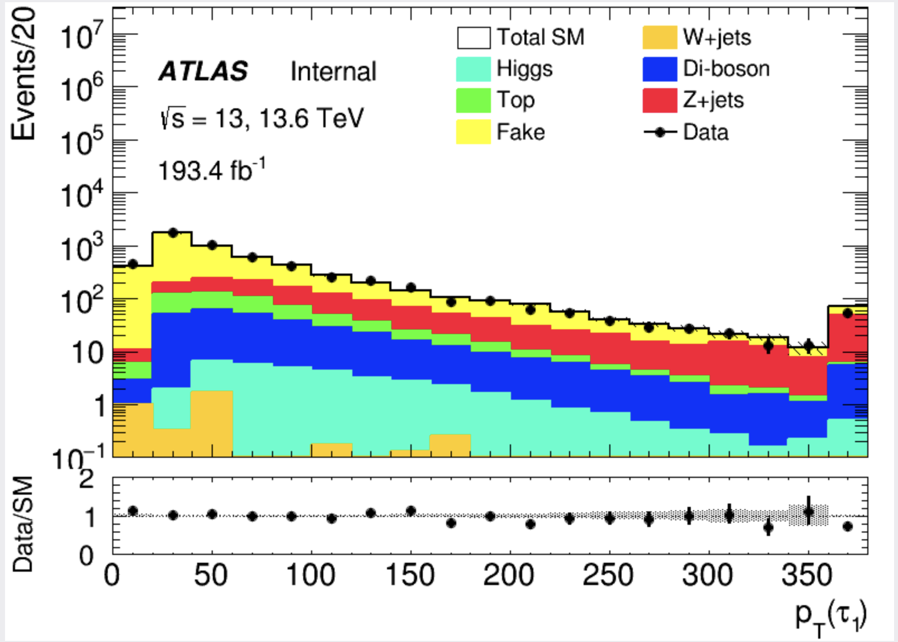
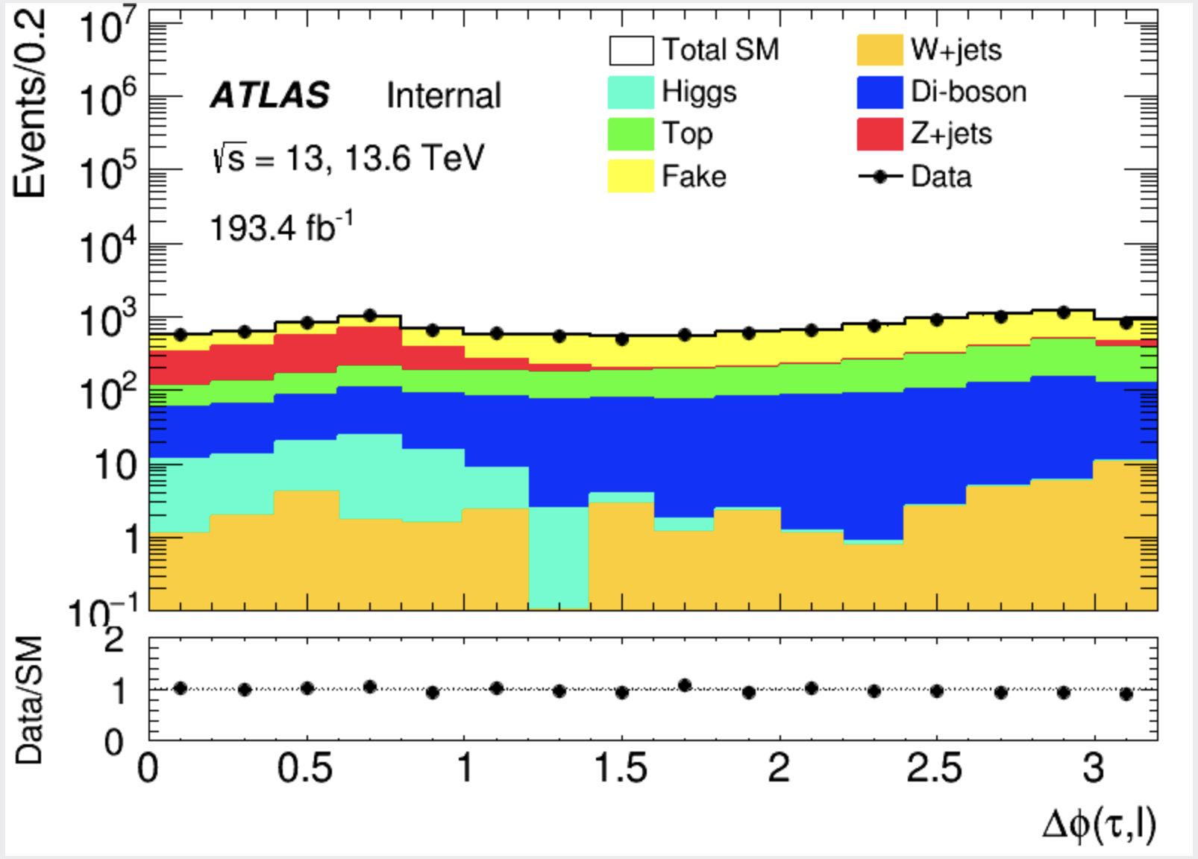
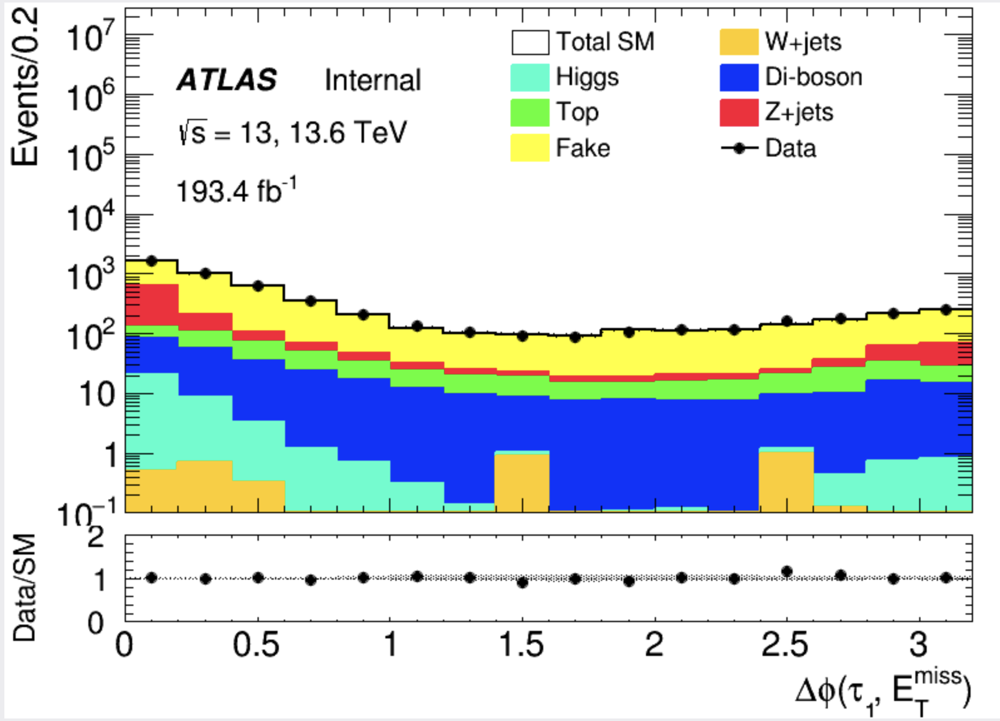
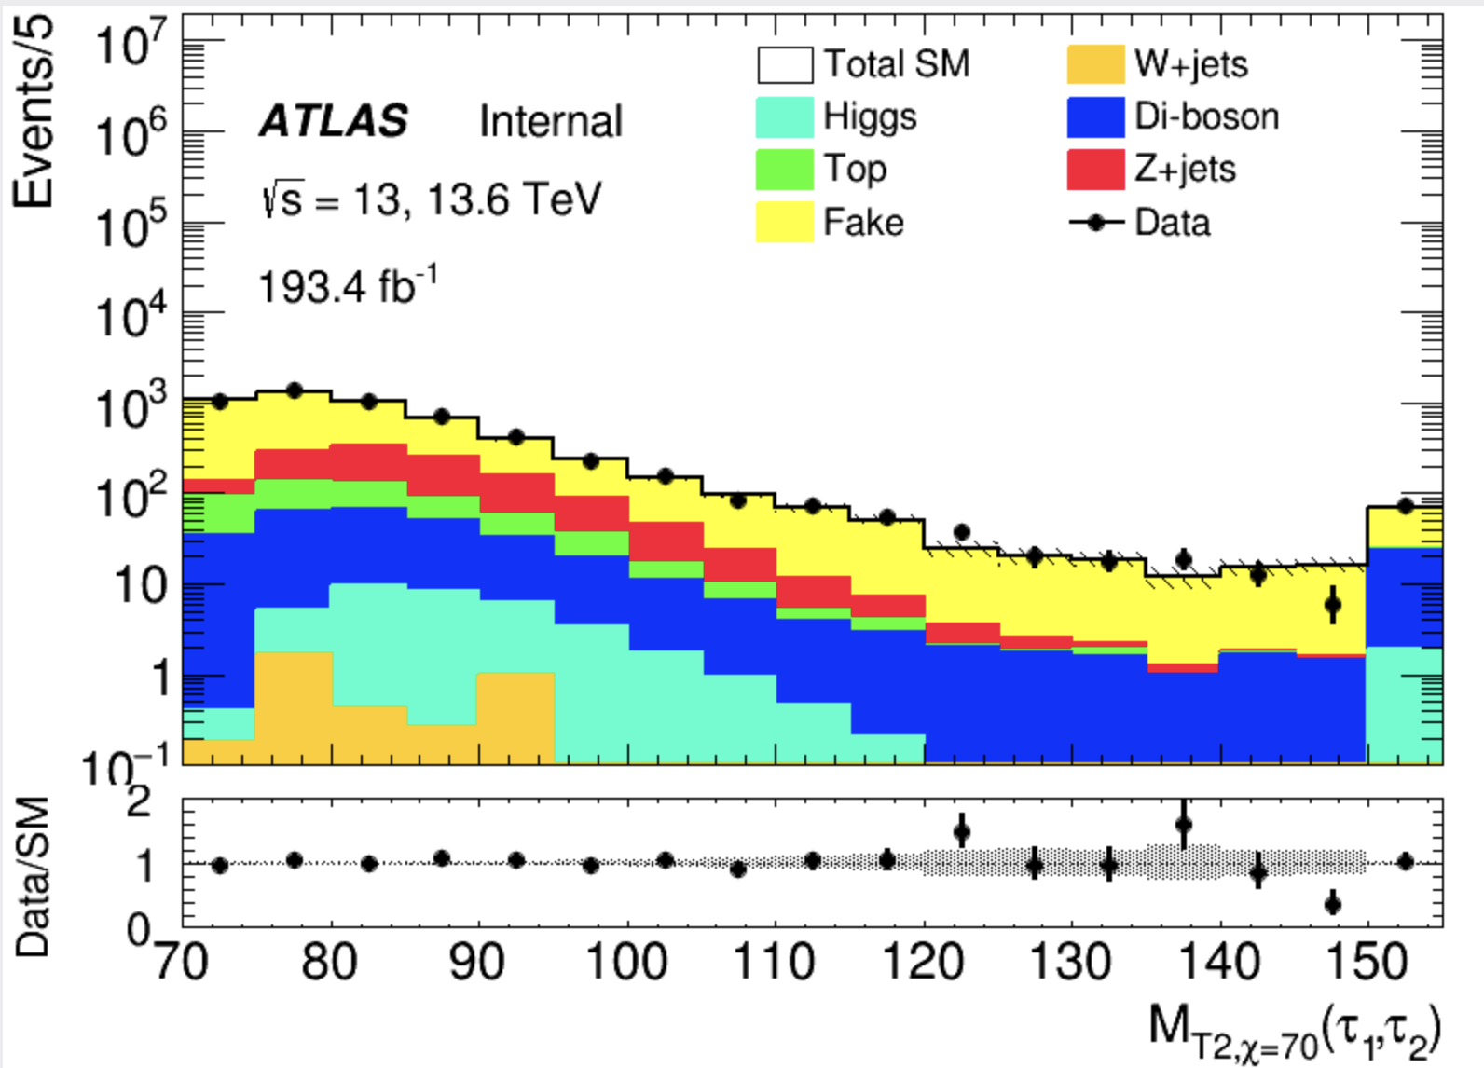
Direct Stau ISR fake estimation validation(HH)
Data-driven fakes in preselection region
More data/MC please check backup
Score distribution
(Pre-selection)
Kinematic distribution
Notes:
换图

Slide 11
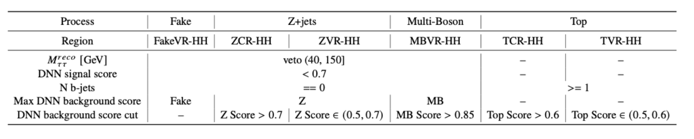
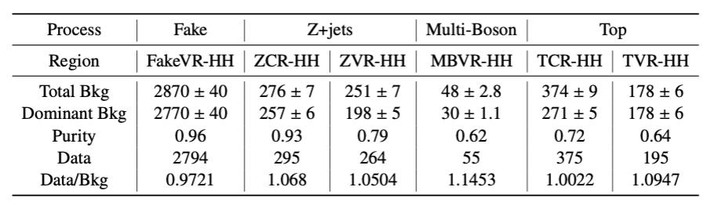
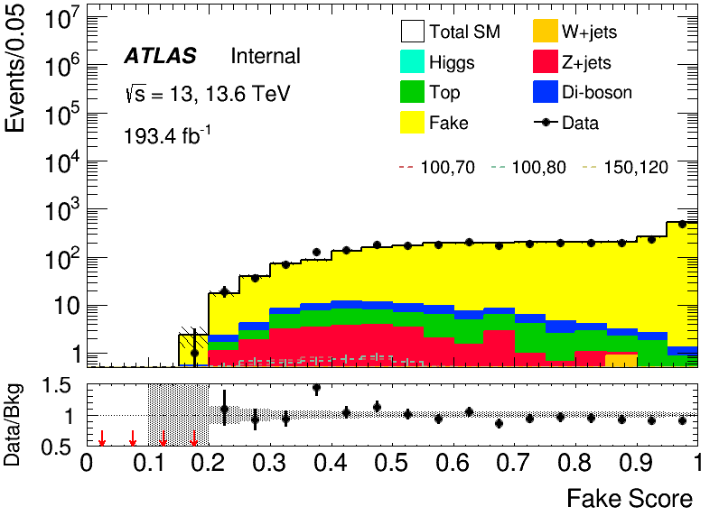
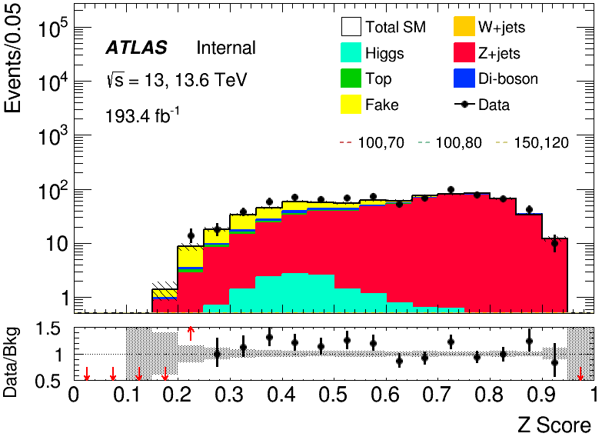
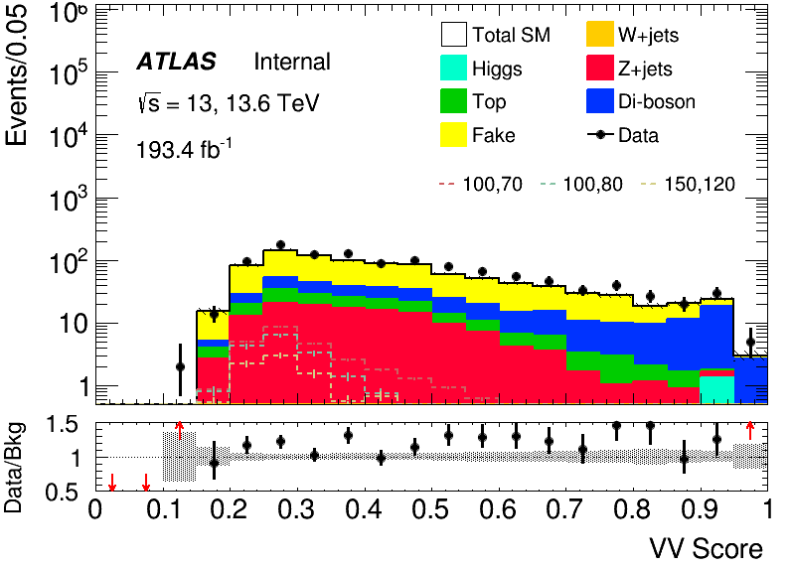
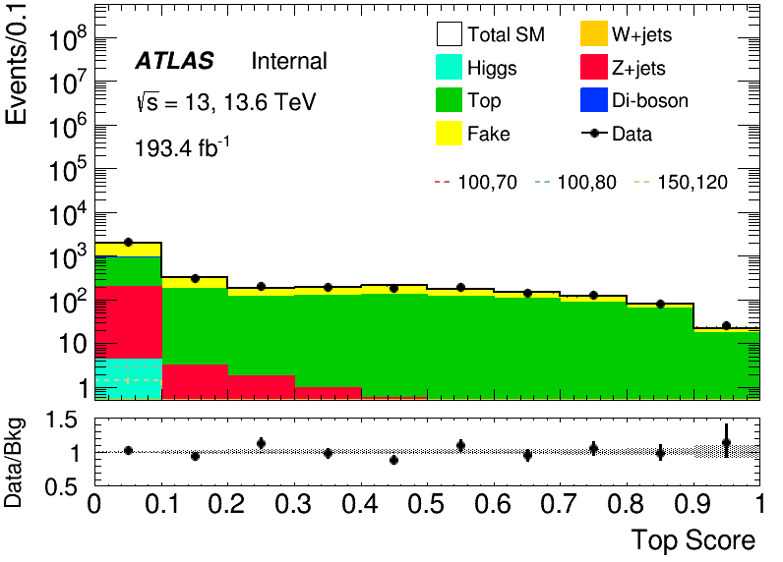
Direct Stau ISR background estimation (HH)
only selections differing from preselection are shown
Z+jets
VV
Top
fake
VR
VR
CR
VR
VR
CR

Slide 12
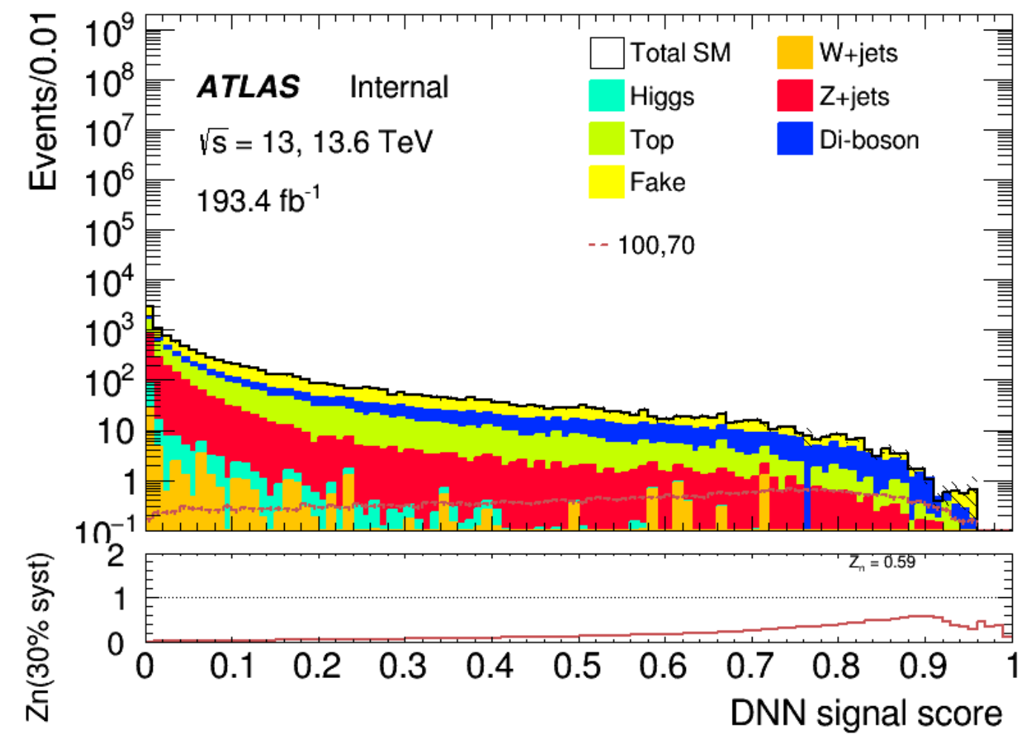
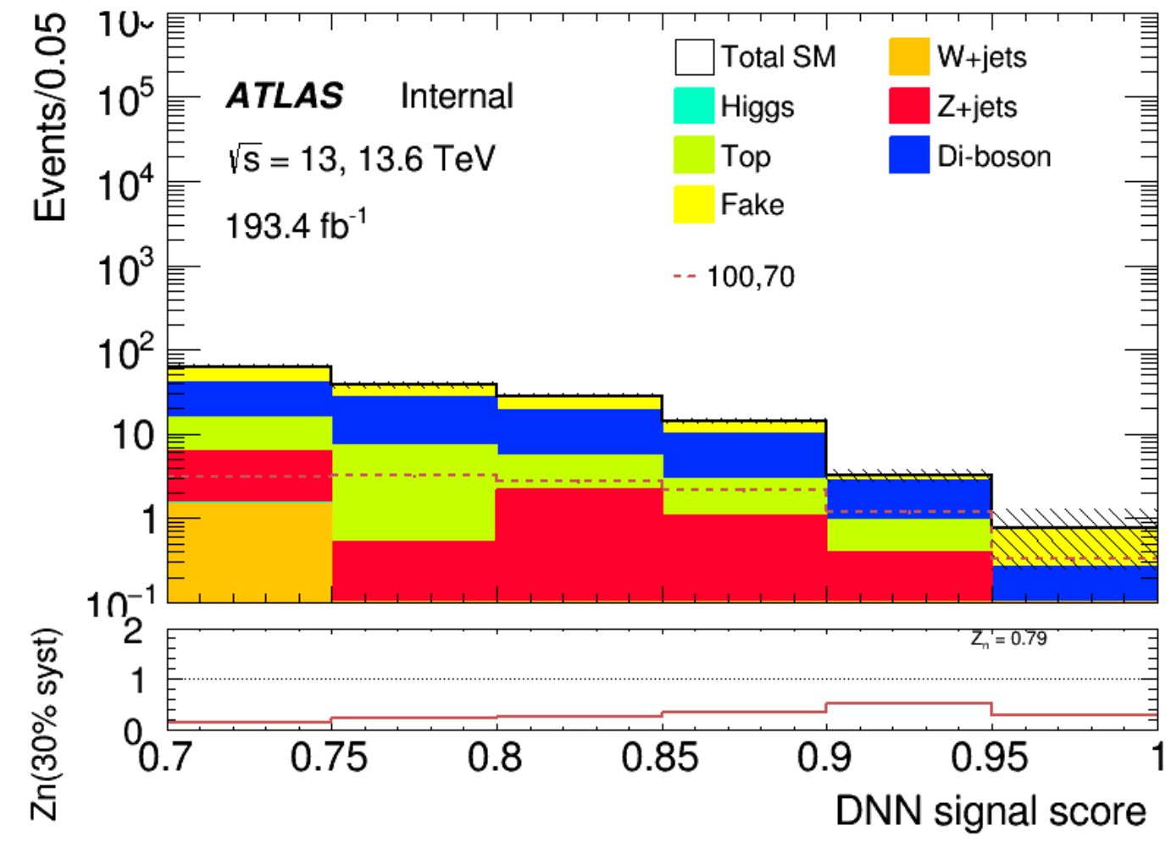
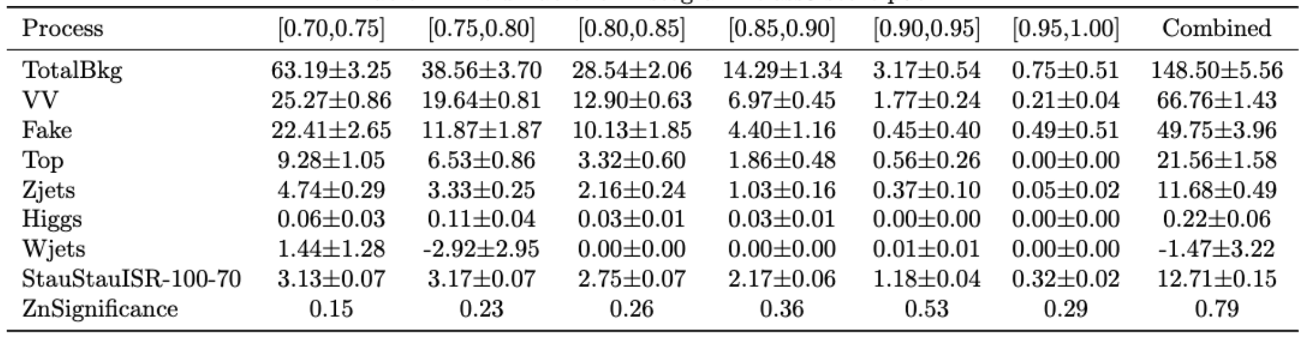
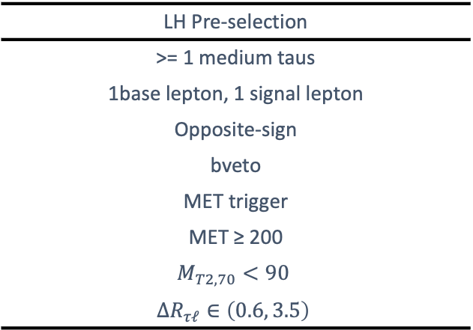
Direct Stau ISR signal region definition(LH)
Preselection
Combined Zn 0.79
LH Pre-selection
>= 1 medium taus
1base lepton, 1 signal lepton
Opposite-sign
bveto
MET trigger
MET ≥ 200
$$M_{T2,70}<90$$
$$ΔR_{τℓ}∈\left(0.6, 3.5\right)$$
Fake tau: W+jets, Top (Fake Factor method)
Background composition
SR selection using neural network score
Real tau: scaled with CRs, validated with VRs
SR
Pre-selection
DNN score > 0.7
Dominant

Slide 13
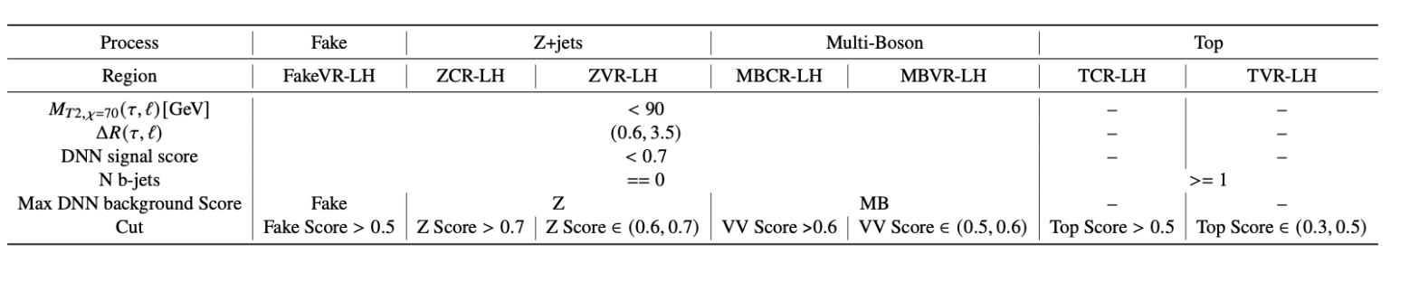
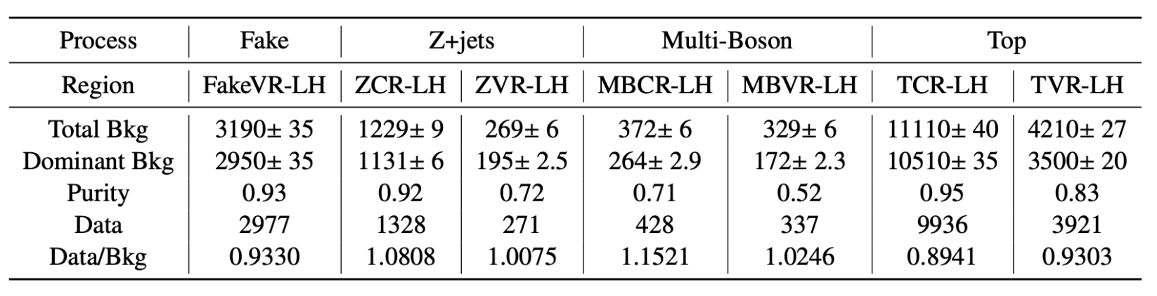
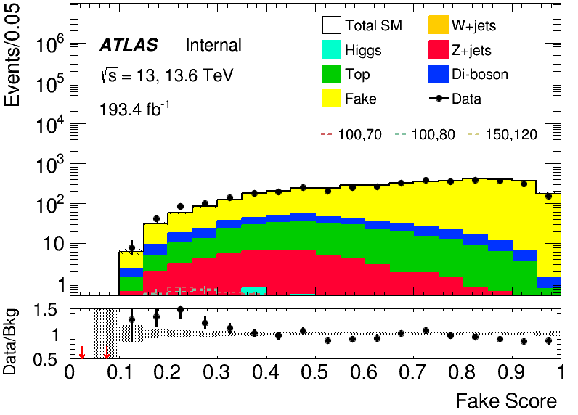
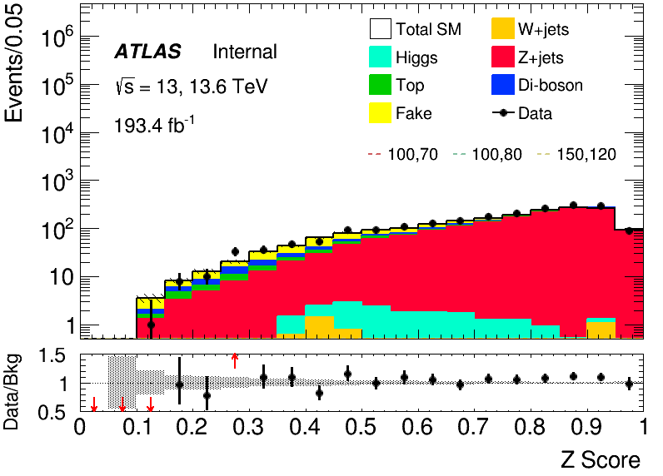
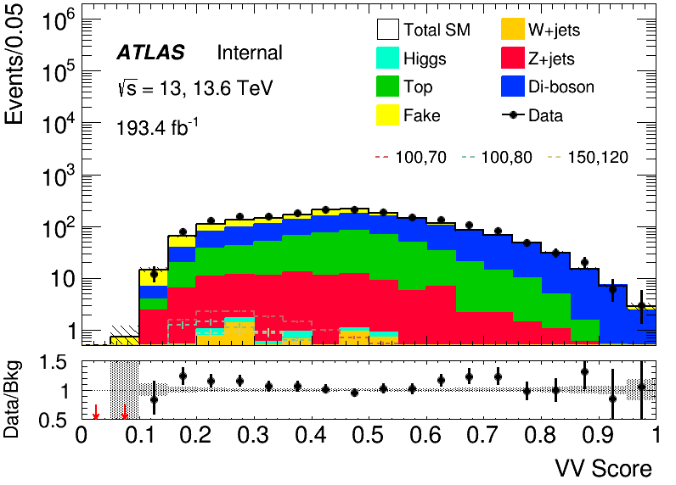
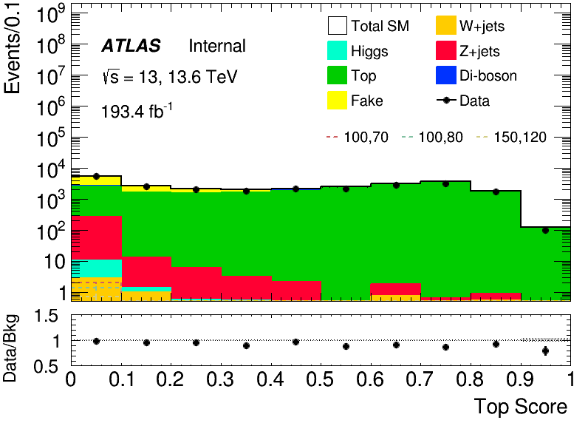
Direct Stau ISR background estimation (LH)
Purity and Data/Bkg performance better than HH
VR
VR
CR
VR
CR
VR
CR

Slide 14
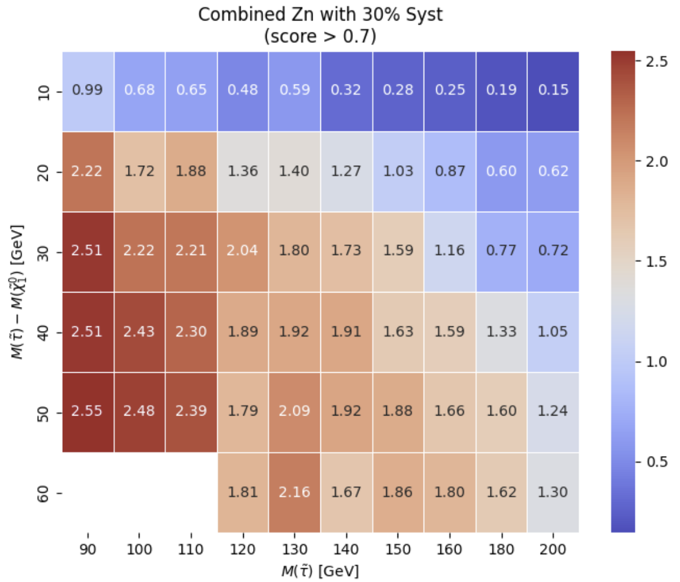
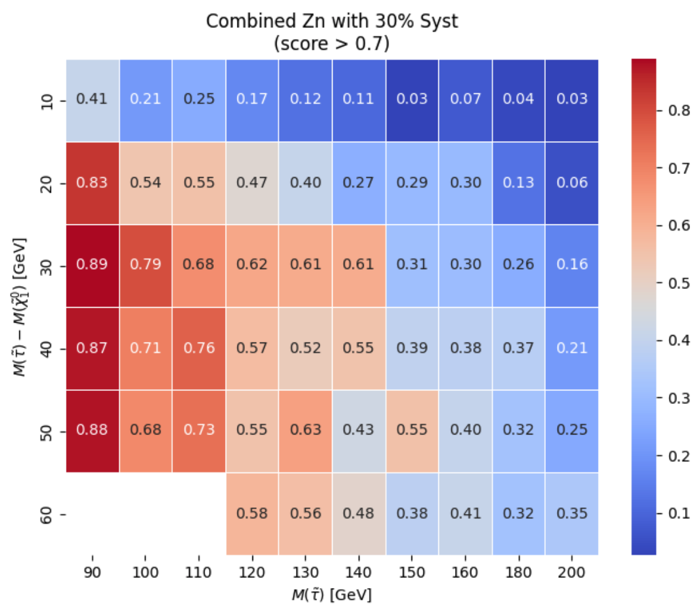
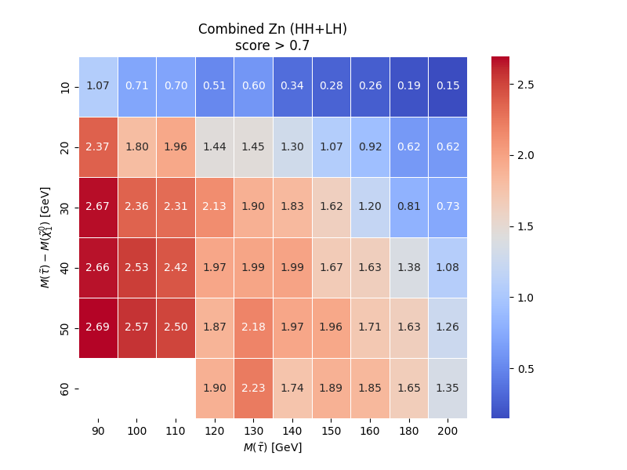
Direct Stau ISR signal region definition
Expected sensitvity
30% flat systematic uncertainty
HH channel
LH channel
Combined channel

Slide 15
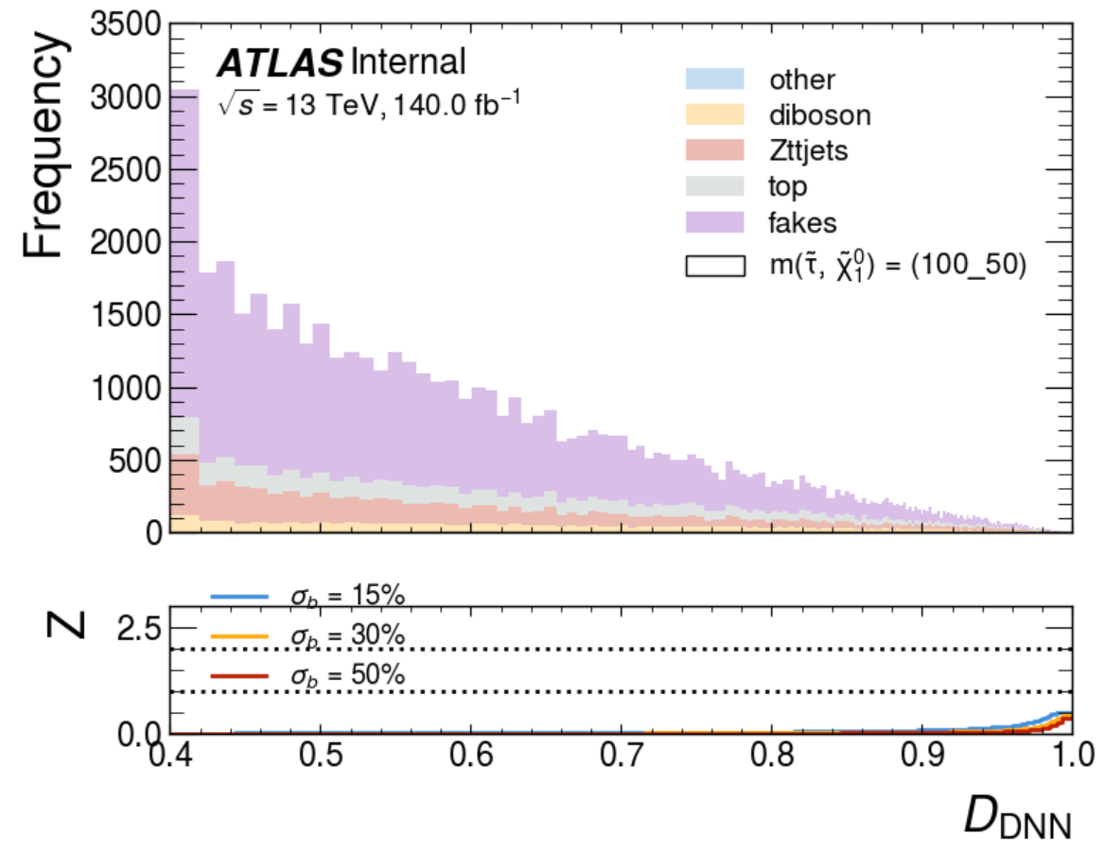




Direct Stau single-lep trigger SR definition(LH)
LH Pre-selection
>= 1 Tight taus
1 signal lepton
OS
bveto
Single-lepton trigger
15 GeV < MET < 200 GeV METSig > 2 MT2 < 90 $$dR\left(lep,tau\right)<3.6$$ custom MT cut*
$φ_{\{1,2\}} cut$*
>=1J channel
Main bkg: fake, Z+jets
=0J channel
CR
VR
SR
SR
CR?
VR?
(orthogonal with ISR SR)
SR
Pre-selection
>=1 Jet | == 0 Jet
DNN score > 0.9
>=1J channel
Z = 1.01
0J channel
Z = 0.36

Slide 16
Direct Stau single-lep trigger background estimation(LH)
>= 1J channel
Region | Selections |  | channel | Total Bkg |  | Dominant Bkg |  | Purity
Fake CR | 0.5 < signal score < 0.7, max bkg score: Fake | fake score > 0.3 | e-channel | 5557 | 10628 | 4746 | 9029 | 0.85 | 0.85
 |  |  | muon-channel | 4283 |  | 4283 |  | 0.84
Top CR | 0.5 < signal score < 0.7, max bkg score: Top | Top score > 0.27 | e-channel | 256 | 555 | 203 | 449 | 0.79 | 0.82
 |  |  | muon-channel | 299 |  | 245 |  | 0.82
Z CR | 0.5 < signal score < 0.7, max bkg score: Z | Z score > 0.28 | e-channel | 457 | 775 | 374 | 631 | 0.82 | 0.82
 |  |  | muon-channel | 317 |  | 256 |  | 0.81
VV CR | 0.0 < signal score < 0.7, max bkg score: VV | VV Score > 0 | e-channel | 145 | 264 | 72 | 134 | 0.50 | 0.50
 |  |  | muon-channel | 118 |  | 61 |  | 0.52
Fake VR | 0.7 < signal score < 0.9, max bkg score: Fake | fake score > 0.2 | -- | 2601 |  | 2166 |  | 0.83
Top VR | 0.7 < signal score < 0.9, max bkg score: Top | Top score > 0.2 | -- | 128 |  | 95 |  | 0.74
Z VR | 0.7 < signal score < 0.9, max bkg score: Z | Z score > 0.165 | -- | 247 |  | 189 |  | 0.76
VV VR | 0.7 < signal score < 0.9, max bkg score: VV | VV score > 0.06 | -- | 166 |  | 84 |  | 0.51
*(Note: MC fakes are only place holders, will be replaced with data driven background in final fit and CR will be added to VR)

Slide 17








Direct Stau single-lep trigger background estimation (LH)
CR-fakes
VR-fakes
e channel
muon channel
CR-fakes
CR-fakes
VR-top
e channel
muon channel
CR-top
CR-top
CR-top
*(Note: MC fakes are only place holders, will be replaced with data driven background in final fit and CR will be added to VR)

Slide 18








Direct Stau single-lep trigger background estimation(LH)
Z CR
Z VR
e-channel
muon-channel
Z CR
Z CR
e-channel
muon-channel
VV CR
VV VR
VV CR
VV CR
*(Note: MC fakes are only place holders, will be replaced with data driven background in final fit and CR will be added to VR)

Slide 19




Direct Stau single-lep trigger background estimation(LH)
= 0J channel
Region | Selections |  | Total Bkg | Dominant Bkg | Purity
Fake CR | 0.5 < signal score < 0.7, max bkg score: Fake | fake score > 0.3 | 18046 | 16348 | 0.91
Z CR | 0.2 < signal score < 0.5, max bkg score: Z | Z score > 0.48 | 345 | 305 | 0.88
Fake VR | 0.7 < signal score < 0.9, max bkg score: Fake | fake score > 0.1 | 17214 | 14782 | 0.85
Z VR | 0.5 < signal score < 0.9, max bkg score: Z | Z score > 0.1 | 766 | 338 | 0.44
CR-fakes-0J
VR-fakes-0J
CR-Ztt-0J
VR-Ztt-0J
fakes: 16348.64
Total: 18046.57
specific bg purity: 91%
fakes: 14782.23
Total: 17214.01
specific bg purity: 85%
Ztt: 338.22
Total: 766.27
specific bg purity: 44%
Ztt: 305.77
Total: 345.52
specific bg purity: 88%
*(Note: MC fakes are only place holders, will be replaced with data driven background in final fit and CR will be added to VR)

Slide 20




Direct Stau single-lep trigger background only fit (LH)
Norm Factor | results | Norm Factor | results
mu_VV | 0.9763+-0.2523 | mu_VV_e | 0.8181+-0.1909
 |  | mu_VV_m | 1.1690+-0.2165
mu_Ztt | 1.2063+-0.2497 | mu_Ztt_e | 1.2519+-0.0929
 |  | mu_Ztt_m | 1.1379+-0.1224
mu_fake | 0.7051+-0.1398 | mu_fakes_e | 0.7060+-0.0259
 |  | mu_fakes_m | 0.7044+-0.0268
mu_top | 1.0451+-0.2208 | mu_top_e | 1.1251+-0.1277
 |  | mu_top_m | 0.9486+-0.0945
FaltSys | -0.0009+-0.9745 | FaltSys | 0.0008+-0.9934
Norm factors indicate overprediction for fake
To be Improved by data-driven estimation
VRs have slight over prediction (but all under 2-sigma)
Combined and Separated show a consistent result.
combined
>= 1 J channel(combined)
>= 1J channel e/mu separate
VR
VR
VV
Z+jets
fake
top
VV
Z+jets
fake
top
e/mu Separated

Slide 21


Direct Stau single-lep trigger background only fit (LH)
= 0 J channel
Norm Factor | results
mu_Ztt | 0.9223+-0.2675
mu_fake | 0.7189+-0.1905
FaltSys | -0.0024
Observe >3 sigma overestimation for fake
Futher solidifies need for data-driven fakes
Z+jets agreement in VR very good
Top and boson minor backgrounds in this channel

Slide 22

Direct Stau single-lep trigger Exclusion Fit(LH)
Preliminary Exclusion fit grid
Model trained on (100,50), (150,100)
All parameters set to their best-fit
20% shape systematic uncertainty

Slide 23




Direct Stau single-lep trigger fake estimation(LH)
CRs (fake factor computation)
Single lepton trigger
OS/SS
1 signal lepton
ID: >= 1 tight tau
antiID: > 0.05 RNN score, no tight tau
SRs
Single lepton trigger
MET > 15GeV
B-veto
OS/SS
ID: >= 1 tight tau
antiID: > 0.05 RNN score, no tight tau
Focus on W+jets and ttbar
MC fakes
Data Driven
Better aggrement for high pt
Binned in prongness, tau pT
FF determination
Data
FF application
Data
MC fakes
Data Driven
CR
Pass ID
SR
Pass ID
Still worse aggrement for high pt
Under investigation
CR
Fail ID
SR
Fail ID

Slide 24



Direct Stau ISR Cut and Count(HH)
Signal Region definition:
Binned for the combination of MT(τ1, MET) and MT(τ2, MET)
HH Pre-selection
>= 2 medium taus (OS)
0 base lepton
bveto
MET trigger
MET ≥ 200 GeV
Primary Jet pt > 200GeV
$$τ_{pt}>20GeV$$
Collinear mass($ττ$) > 250GeV
SR before binned
Pre-selection
$$M_{T2}\left(0\right)<5GeV$$
$$M_{T2}\left(70\right)<85GeV$$
$$dφ\left(MET,Jet\right)>0.4$$
$$dη\left(τ_{1},τ_{2}\right)<2.0$$
$$dR\left(τ_{1},τ_{2}\right)<3.2$$
$$dR\left(τ,MET \right)>1$$
$$M_{T}\left(τ_{1},MET\right)>80GeV$$
$$M_{T}\left(τ_{2},MET\right)>60GeV$$

Slide 25

Direct Stau ISR Cut and Count(HH)
Sensitivity for any pair production of ${\tilde{τ}}_{l}$ + ${\tilde{τ}}_{R}$ pair-production with 30% flat systematic uncertainty
 | SR1 | SR2 | SR3 | SR4 | All
VV | 1.71 ± 0.24 | 2.22 ± 0.40 | 2.08 ± 0.28 | 0.96 ± 0.18 | 6.97
Top | 1.64 ± 0.58 | 0.97 ± 0.43 | 0.20 ± 0.20 | 0.32 ± 0.23 | 3.13 ± 0.78
Wjets | 0.0 | 0.18 ± 0.27 | 0.71 ± 0.3 | 0.0 | 0.89 ± 0.40
Zjets | 0.57 ± 0.11 | 0.59 ± 0.15 | 0.53 ± 0.18 | 0.20 ± 0.10 | 1.89 ± 0.28
BG Sum | 3.92 ± 0.64 | 3.96 ± 0.66 | 3.52 ± 0.49 | 1.28 ± 0.10 | 12.68 ± 1.05
Signal (100, 70) | 1.64 ± 0.06 | 2.00 ± 0.07 | 1.85 ± 0.07 | 1.69 ± 0.06 | 7.18 ± 0.13
Significance (100, 70) | 0.66 | 0.79 | 0.78 | 1.11 | 1.70

Slide 26



Direct Stau ISR Cut and Count(LH)
LH Pre-selection
>= 1 medium taus
1 base lepton, 1 signal lepton
OS
bveto
MET trigger
MET ≥ 130 GeV
Primary Jet pt > 50GeV
$$τ_{pt}>25GeV$$
Collinear mass($τl$) > 130GeV
Signal Region definition:
Binned for the combination of the number Jets and tau pT
SR before binned
Pre-selection
$$M_{T2}\left(40\right)<55GeV$$
$$\frac{pt_{lep}}{M_{T}\left(τ_{1},MET\right)}<0.1$$
$$M_{T}\left(τ_{1}, MET\right)>90GeV$$

Slide 27
Direct Stau ISR Cut and Count(LH)
Sensitivity map with 30% systematic uncertainty
 | SR1 | SR2 | SR3 | SR4 | All
VV | 6.24 ± 0.66 | 11.01 ± 1.00 | 4.27 ± 0.64 | 5.83 ± 0.72 | 27.35 ± 1.53
Top | 5.93 ± 1.44 | 11.02 ± 1.91 | 4.48 ± 1.26 | 7.80 ± 1.62 | 29.23 ± 3.15
Wjets | 13.48 ± 3.74 | 28.78 ± 5.50 | 13.60 ± 3.88 | 18.49 ± 5.21 | 74.35 ± 9.30
Zjets | 5.71 ± 0.66 | 7.67 ± 0.74 | 1.71 ± 0.39 | 4.17 ± 0.64 | 19.27 ± 1.25
BG Sum | 31.36 ± 4.11 | 58.49 ± 5.96 | 24.06 ± 4.15 | 36.28 ± 5.54 | 150.20 ± 10.02
Signal (100, 70) | 1.7 ± 0.06 | 1.22 ± 0.05 | 1.08 ± 0.05 | 0.84 ± 0.04 | 4.84 ± 0.10
Significance | 0.15 | 0.06 | 0.12 | 0.07 | 0.4

Slide 28

Direct Stau ISR Background Estimation

Slide 29

Direct Stau ISR Background Estimation

Slide 30
Direct Stau ISR Background Estimation
Diboson CR
Top CR
Z+jets CR
W+jets CR

Slide 31

C1C1 ISR signal region optimization
Preselection for HH and LH channel
BDT method for signal region optimization
Figure of merit: combined Zn
30% flat systemic uncertainty
5-fold Cross-Validation
HH Pre-selection
>= 2 medium taus
0 base lepton
MET ≥ 200 GeV; pass MET trigger
1≤nJet
Opposite-sign hadronic-hadronic tau pair
bveto
jet pt>100 GeV
LH Pre-selection
>= 1 medium taus
1 base lepton, 1 signal lepton
MET ≥ 200 GeV; pass MET trigger
1≤nJet
Opposite-sign lepton-hadronic tau pair
bveto
jet pt>100 GeV
Best performance for HH and LH channel

Slide 32



C1C1 ISR signal region definition(HH)
SR
Pre-selection
BDT score > 0.9
Binned significance: 3.32
Sensitivity map

Slide 33

C1C1 ISR signal region definition(LH)
SR
Pre-selection
BDT score > 0.9
Binned significance: 5.36
Sensitive map

Slide 34



C1C1 ISR background estimation(LH)
Region | Selections |  | Total Bkg | Dominant Bkg | Purity | Data | Data/Bkg
Top CR | Pre-selection bTag | $$M_{T}\left(lep,MET\right)>200$$ | 8367+-34 | 8043+-34 | 0.96 | 7404 | 0.89
Z CR | Pre-selection $$40<M_{ττ}^{reco}<100$$ | BDT score < -0.8 | 1615+-16 | 1272+-15 | 0.79 | 1611 | 0.99
Top VR | Pre-selection bTag | $$120<M_{T}\left(lep,MET\right)<200$$ | 5674+-35 | 5345+-34 | 0.94 | 5141 | 0.90
Z VR | Pre-selection $$40<M_{ττ}^{reco}<100$$ | -0.8 < BDT score < 0.9 | 623+-12 | 472+-10 | 0.76 | 619 | 0.99
Z+jets
Top
CR
VR
CR
VR

Slide 35




C1N2 ISR signal region optimization
Preselection for HH and LH channel
BDT method for signal region optimization
Figure of merit: AUC
5-fold Cross-Validation
HH Pre-selection
>= 2 medium taus
0 base lepton
MET ≥ 200; pass MET trigger
1≤nJet
Opposite-sign hadronic-hadronic tau pair
bveto
jet pt>100 GeV
$$M_{ττ}^{reco}<40 GeV or M_{ττ}^{reco}>130 GeV$$
LH Pre-selection
>= 1 medium taus
>=1 base lepton, >=1 signal lepton
MET ≥ 200; pass MET trigger
1≤nJet
Opposite-sign lepton-hadronic tau pair
bveto
jet pt>100 GeV
$$M_{ττ}^{reco}<40 GeV or M_{ττ}^{reco}>130 GeV$$
Penalty function to balance the AUC and overfit
Grid Search for the best model

Slide 36






C1N2 ISR signal region definition(HH)
Combined Zn 7.56
SR definition using BDT score(HH)
Three bins [0.80, 0.86], [0.86, 0.90], [0.90, 1.00]
HH Pre-selection
>= 2 medium taus
0 base lepton
MET ≥ 150; pass MET trigger
1≤nJet
Opposite-sign hadronic-hadronic tau pair
bveto
jet pt>100 GeV
$$M_{ττ}^{reco}<40 GeV or M_{ττ}^{reco}>130 GeV$$
SR
Pre-selection
BDT score > 0.8

Slide 37





C1N2 ISR fake estimation validation(HH)
Data-driven fakes in preselection region
More data/MC please check in backup
Score distribution
(Pre-selection)
Kinematic distribution
Notes:
换图

Slide 38




C1N2 ISR background estimation(HH)
Selection for control region and validation region
Orthorgonal with SR
Top
Z+jets
VV
Fake
CR
VR
VR
CR
VR
VR
VR

Slide 39




C1N2 ISR signal region definition(LH)
Combined Zn 4.934
SR definition using BDT score(LH)
Three bins [0.91, 0.94], [0.94, 0.96], [0.96, 1.00]
LH Pre-selection
>= 1 medium taus
>=1 base lepton, >=1 signal lepton
MET ≥ 200; pass MET trigger
1≤nJet
Opposite-sign lepton-hadronic tau pair
bveto
jet pt>100 GeV
$$M_{ττ}^{reco}<40 GeV or M_{ττ}^{reco}>130 GeV$$
SR
Pre-selection
BDT score > 0.91

Slide 40




C1N2 ISR background estimation(LH)
Selection for control region and validation region
Z+jets
VV
Fake
Top
VR
VR
CR
VR
VR
VR
CR

Slide 41



C1N2 ISR signal region definition
Expected sensitivity
30% flat systematic uncertainty
gap caused by interpolation algorithm
Result only for full run2 sample, will update to full run2 + partial run3 sample later
HH channel
LH channel
Combined channel

Slide 42
Summary and Outlook
Direct stau
ISR channel
Inclusive channel
C1C1/C1N2 channel
DNN approach
Preliminary SRs/CRs/VRs
Fake factor estimation
Expected signal sensitivity
DNN approach
Preliminary SRs/CRs/VRs
Fake Factor Method(Ongoing)
Bkg only fit
Expected CLs(preliminary)
BDT approach
Preliminary SRs/CRs/VRs
Fake factor estimation
Expected signal sensitivity

Slide 43
TODO
1. Finalize SRs/CRs/VRs for all scenarios
2. Systematics studies
3. Expected limit with uncertainty
4. Internal note to be prepared for EB request

Slide 44
Backup

Slide 45
Direct stau ISR part

Slide 46










Direct Stau ISR MC modeling(HH)
Full run2 + partial run3

Slide 47









Direct Stau ISR MC modeling(LH)
Full run2 + partial run3

Slide 48




Direct Stau ISR Fake purity in CR
1-prong
3-prong
ID
anti-ID

Slide 49


Direct Stau ISR Fake Factor
Binned in prongness, tau eta, tau pT
Eta bins
2 bins: central [0,1.37], forward [1.52,2.5]
3 bins: eta0,1,2 for [0,1), [1, 1.37], [1.52,2.5]
Auto binning:
> 10% of events in nominator and denominator
Add bins to bin i until it is not consistent anymore with bin i - 1
Relative stat uncertainty on ratio smaller than 50%
>10% events in nominator and denominator
1-prong: 3 eta bins
3-prong: central, forward regions

Slide 50

Direct Stau ISR Neuron network(HH)
Train: Val: Test = 0.72 : 0.18 : 0.1
Model Architecture
Model: MLP
Hidden layers: [256, 128, 128, 64, 32]
Activation Function: Leaky ReLU
Batch Normalization
Dropout Rate: 0.3
L2 Regularization (λ): 1e-4
Training Configuration
Optimizer: Adam
Learning Rate: 1e-3
Batch Size: 128
Epochs: 600
Reduce Learning Rate on Plateau:
Monitor: val_loss
Factor: 0.5
Patience: 20
Class
1: ISR (100,70)
2: Fake
3: MB
4: Top
5: Zjets
6: Higgs, W+jets
Class weight to solve imbalance issue
Importance factor: [1, 1, 1, 0.5, 0.5, 0.1]
Normalization before training: $\frac{X−μ}{σ}$
Drop negative weight events of train dataset for training

Slide 51

Direct Stau ISR Class Weight
$w_{i}=I_{i}⋅\frac{N_{all}}{n_{class}×N_{i}}$
$N_{all}$​: The total sum of weight in the entire dataset (across all classes).
$N_{i}$: The sum of weight belonging to class i.
$n_{class}$: The total number of distinct classes in the dataset.
$I_{i}$: importance factor

Slide 52






Direct Stau ISR Neuron network(HH)
Model Architecture
Neurons: [256, 128, 128, 64, 32]
Activation Function: Leaky ReLU
Batch Normalization
Dropout Rate: 0.3
L2 Regularization (λ): 1e-4
Training Configuration
Optimizer: Adam
Learning Rate: 1e-3
Batch Size: 128
Epochs: 600
Reduce Learning Rate on Plateau:
Monitor: val_loss
Factor: 0.5
Patience: 20
Class weight to solve imbalance issue
Normalization before training
$\frac{X−μ}{σ}$
Drop Negative weight
52

Slide 53








Direct Stau ISR Neuron network(LH)
AUC for 6 output scores
ISR
Fake
VV
Top
Zjets
Others
(W+jets,Higgs)

Slide 54
Direct stau single-lep trigger part

Slide 55






Direct Stau single-lep trigger MC modeling check
2015+16
2017
2018
Requirements: 1e/mu passing trigger, at least 1 tight signal tau
MC overestimates data
2015+16
2017
2018

Slide 56






Direct Stau single-lep trigger MC modeling check
2022
2023
2024
Requirements: 1e/mu passing trigger, at least 1 tight signal tau
MC overestimates data
2022
2023
2024

Slide 57







Direct Stau single-lep trigger Pre-selection(LH)
*custom MT cut (removes red shape):
Targets Ztt
(mT_sum > 70_000) &
((mT_lep_met > 20_000) | (mT_tau_met > 90_000)) &
((mT_lep_met > 90_000) | (mT_tau_met > 20_000))
*phi_{1,2} cut (removes red circle slice):
Targets fakes
Define:
Cut:
(abs(phi1)-a)**2 + (abs(phi2)-b)**2 >= r**2
where a=pi, b=pi, and r = pi/2
Zττ+jets
LH Pre-selection
== 1 Tight taus (OS)
1 signal lepton
bveto
Single-lepton trigger
15 GeV < MET < 200 GeV METSig > 2 MT2 < 90 $$dR\left(lep,tau\right)<3.6$$ custom MT cut*
$φ_{\{1,2\}} cut$*
before: 275.78
after: 263.50
before: 71267.95
after: 24429.68
W+jets
before: 263.50
after: 257.31
before: 207701.89
after: 145037.45

Slide 58


Direct Stau single-lep trigger DNN Training
Train deep neural network (DNN) to separate signal from background and cut on network score targeting (100, 50) & (150,100) mass points (high stats points with 1M events generated) and trained 0J and >=1J channels separately.
Training converges well (across all training folds) and very good signal/background separation is achieved
Use multiclass DNN with 6 output classes: Signal, fake-tau background, 4 real-backgrounds (top, Ztt, VV, other)
Input variables:
Basic object variables: p_{T}, η, MET, charge etc.
High-level variables: ΔR, Δη, Δφ, m_{T2}, M_{eff}, M_{inv}, Σm_{T}, m_{CT}, balance + more!
Training loss
Validation loss

Slide 59




Direct Stau single-lep trigger Fake Factors

Slide 60




Direct Stau single-lep trigger Fake Factors

Slide 61

Direct Stau single-lep trigger Exclusion Fit(LH)
>= 1J channel
Type of systematic | % Syst. | [ | Expected CLs | ]
Normalisation | 1 | 0.238 | 0.437 | 0.699
Normalisation | 10 | 0.238 | 0.437 | 0.699
Normalisation | 20 | 0.238 | 0.437 | 0.699
Normalisation | 50 | 0.240 | 0.439 | 0.701
Norm+Shape | 1 | 0.238 | 0.437 | 0.699
Norm+Shape | 20 | 0.238 | 0.437 | 0.699
Norm+Shape | 50 | 0.240 | 0.439 | 0.701
expected CLs very robust to systematics
Sensitivity worse than estimated from simple Z score formula
(Mu factors preliminary since dominant fake background MC will be replaced)*

Slide 62

Direct Stau single-lep trigger Exclusion Fit(LH)
0J and >= 1J channel combined
a slight decrease in the expected CLs, but not much
DNN studies showed >=1J channel drives sensitivity
Type of systematic | % Syst. | [ | Expected CLs | ]
Normalisation | 20 | 0.231 | 0.429 | 0.693
Norm+Shape | 20 | 0.231 | 0.429 | 0.693

Slide 63

Direct Stau single-lep trigger OS-SS Fit(LH)
Idea to use same-sign (SS) region in the fit to constrain systematics
small impact on resulting CLs value
Type of fit | % Syst. | [ | Expected CLs | ]
OS only | 20 | 0.242 | 0.442 | 0.703
OS-SS | 20 | 0.242 | 0.441 | 0.702

Slide 64




Direct Stau single-lep trigger fake estimation(LH)
Focus on events with taus with pT 20-25 GeV
Top: OS
Bottom: SS
Better agreement with data-driven fake taus compared to MC for different numbers of jets in the event

Slide 65
Direct stau ISR cut&count part

Slide 66

Direct Stau ISR Cut and Count Top, Ztt CR

Slide 67

Direct Stau ISR Cut and Count Diboson CR

Slide 68

Direct Stau ISR Cut and Count VRs

Slide 69
C1C1/C1N2 ISR part

Slide 70








C1N2 ISR MC modeling(HH)
Full run2 + partial run3 after data-driven

Slide 71








C1N2 ISR MC modeling(LH)
Full run2 + partial run3 after data-driven

Slide 72
C1C1 ISR signal region optimization(HH)
Input:
data: MC events passing pre-selection
signal: 39382 events C1C1 + ISR, M(C1, N1) = (100, 70) GeV
Bkg: 1089081 events.
feature:Pzetaj1,Pzetae,MCTtt,m_jet,dPhiISRV,dPhiVI,nS_tau,PtV,dPhit2x,maxdPhit1j,maxdPhit2j,METOPttau2,METOHTtt,METOHTjet,Ptjet1OPttau1,MT2tt_110,mtx_jet,mtx_lep,mt_lep,mt_C1C1,MTtau2met,MTtaumin,MTsum,Mtsum,Mtsumj,Mll,MT2,MET,METsig
Strategy
TMVA.Types.kBDT
Cross-Validation(5-fold)
hyper paramter: NTrees=400,learning rate=0.1,max depth=8, MinNodeSize=1%
other set-up: nCuts=20:BoostType=Grad:UseBaggedBoost=true:BaggedSampleFraction=0.5:NegWeightTreatment=Pray

Slide 73
C1C1 ISR signal region optimization(LH)
Input:
data: MC events passing pre-selection
signal: ISRC1C1(with C1 mass=100GeV, N1 mass=70 GeV)(39336 events)
bkg(1559557 events).
feature: dRt1x,dRtt,dPhitt,e_lep,mt_lep,ht_tau,METsig,nBaseJet,mindPhije,maxdPhit2j,MTtau1met,MTtau2met,MTtaumin,
MTtot,MTsum,Minvtt,Minvt2j,MT2tt_110,MCTtt,Pzetaj1,Pzetatt,METOPttau1,METOPttau2,METOHTtt,METOHTjet,Ptjet1OPttau1,Ptjet1OPttau2,Ptjet1OHTtt,PtV
Strategy
TMVA.Types.kBDT
5-fold train
hyper paramter: NTrees=300,learning rate=0.05,max depth=6, MinNodeSize=1%
other set-up: nCuts=20:BoostType=Grad:UseBaggedBoost=true:BaggedSampleFraction=0.5:NegWeightTreatment=Pray

Slide 74

C1N2 ISR Binary class(HH)
Hyperparameters: Ntrees = 200, MaxDepth = 6, MinNodeSize = 2%, Learning rate = 0.03(initial setting)
Feature engineering: Select a simple model and put all features into model, choose Top 30 vars based on importance list, drop high correlated vars Final feature list:
Weight choose: no weight, abs(weight)
No weight have better performance but abs(weight) fit our anaysis requirment
Split strategy: Separate entries by using mod 5, for Fake bkg, if separate follow sequence, all weighted entry will split into first fold

Slide 75
C1N2 ISR Binary class(HH)
Class: C1N2, bkg
Hyperparameter tune: use optuna to auto-optimze
Test_auc = \sum{Test_auc_class} Train_auc = \sum{Train_auc_class}
constraint: average of AUC need to >= 0.6 penalty function: score = test_auc – 0.3*auc_gap (auc_gap = abs(train_auc- test_auc)) maximum(score)
Grid Search Ntrees: [200, 300, 400]
MaxDepth: [4, 6, 8, 10] MinNode: [1, 3, 5, 7]
Learning rate: [0.001, 0.005, 0.01, 0.05, 0.1]
Best one: Ntree=300, MaxDepth=6, MinNode=1%, Learning Rate=0.05
There still have rooms to optimize for lr

Slide 76





C1N2 ISR Binary class(HH)
Overfit Check

Slide 77





C1N2 ISR Binary class(HH)
50 bins
Cut at 0.8
rebin
Sum Zn = 7.65

Slide 78

C1N2 ISR Binary class(LH)
Hyperparameters: Ntrees = 200, MaxDepth = 6, MinNodeSize = 2%, Learning rate = 0.03(initial setting)
Feature engineering: Select a simple model and put all features into model, choose Top 30 vars based on importance list, drop high correlated vars Final feature list:
Weight choose: no weight, abs(weight)
No weight have better performance but abs(weight) fit our anaysis requirment
Split strategy: Separate entries by using mod 5, for Fake bkg, if separate follow sequence, all weighted entry will split into first fold

Slide 79





C1N2 ISR Binary class(LH)
Overfit Check

Slide 80




C1N2 ISR Binary class(LH)
100 bins
Cut at 0.91
rebin
Narrow peak
Sum Zn = 4.934

Slide 81



C1N2 ISR fake estimation(HH)
CRs (fake factor computation)
METtrig
MET>=200
bveto
at least 1 signal lepton
$Δφ(τ,MET)>2$
ID: >= 1 medium tau
antiID: >= 1 VeryLoose tau, 0 medium tau
SRs
preselection
2ID: >= 2 medium tau
1ID1antiID: >= 2 VeryLoose tau , 1 medium tau
2antiID: >= 2 VeryLoose tau , 0 medium tau
FF determination
Data
FF determination
Data
CR
Pass ID
SR
Pass ID
SR
but
1 tau Fail ID
CR
Fail ID
SR
but
2 tau Fail ID
Binned in prongness, tau eta, tau pT
Eta bins
2 bins: central [0,1.37], forward [1.52,2.5]
3 bins: eta0,1,2 for [0,1), [1, 1.37], [1.52,2.5]
Auto binning:
> 10% of events in nominator and denominator
Add bins to bin i until it is not consistent anymore with bin i - 1
Relative stat uncertainty on ratio smaller than 50%
>10% events in nominator and denominator

